Slide 1
Session 4: Mutation calling
and analysis
Emerging Approaches For Tumor Analyses
in Epidemiological Studies
January 11, 2023
9:30 AM- 12:00 PM
Notes:
Even though the session is called mutation calling and analysis, to clarify, we will mostly discuss somatic mutation calling rather than germline mutation calling as this is the main focus of the entire workshop. Many somatic variant calling pipelines are distinct from those to call germline variants.

Slide 2
Session Overview
Introduction to somatic variants
Framework for short variant discovery (GATK)
Variant callers
Variant filtering and annotation
IGV for visualization and validation
Common somatic mutational analyses
Workshop website: https://nci-iteb.github.io/tumor_epidemiology_approaches/

Slide 3
Session 4: Mutation calling
and analysis
Emerging Approaches For Tumor Analyses
in Epidemiological Studies
January 11, 2023
9:30 AM- 12:00 PM
Notes:
Even though the session is called mutation calling and analysis, to clarify, we will mostly discuss somatic mutation calling rather than germline mutation calling as this is the main focus of the entire workshop. Many somatic variant calling pipelines are distinct from those to call germline variants.

Slide 4
Introduction to somatic variants

Slide 5
Why call somatic variants?
The Cancer Genome Atlas (TCGA) Program Overview:
“There are at least 200 forms of cancer, and many more subtypes. Each of these is caused by errors in DNA that cause cells to grow uncontrolled. Identifying the changes in each cancer’s complete set of DNA – its genome – and understanding how such changes interact to drive the disease will lay the foundation for improving cancer prevention, early detection and treatment.”
Notes:
First of all, why call somatic variants in the first place. Many if not most of you are probably familiar the The Cancer Genome Atlas (or TCGA) program which molecularly characterized over 20,000 primary cancer and matched normal samples spanning 33 cancer types. The TCGA program overview really addresses the importance of calling somatic variants. Cancers are caused by errors in DNA. Therefore, the identification of the somatic variants and how they interact will enable us to understand what drive cancer development, therefore laying the foundation for improving cancer prevention, early detection and treatment.

Slide 6
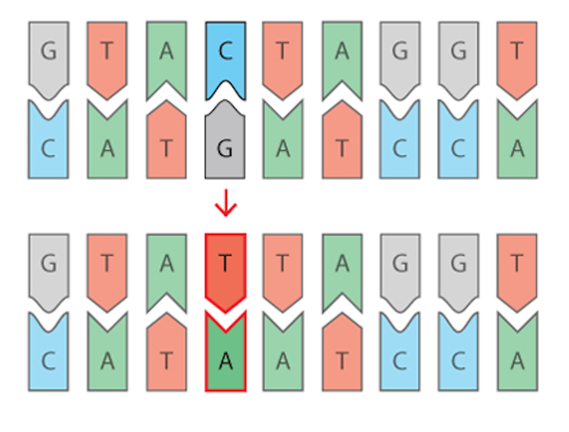
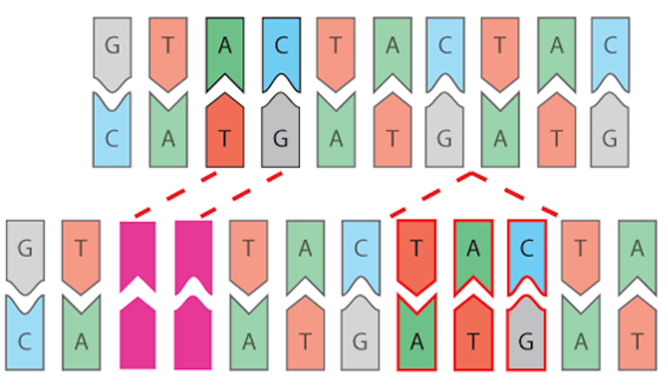
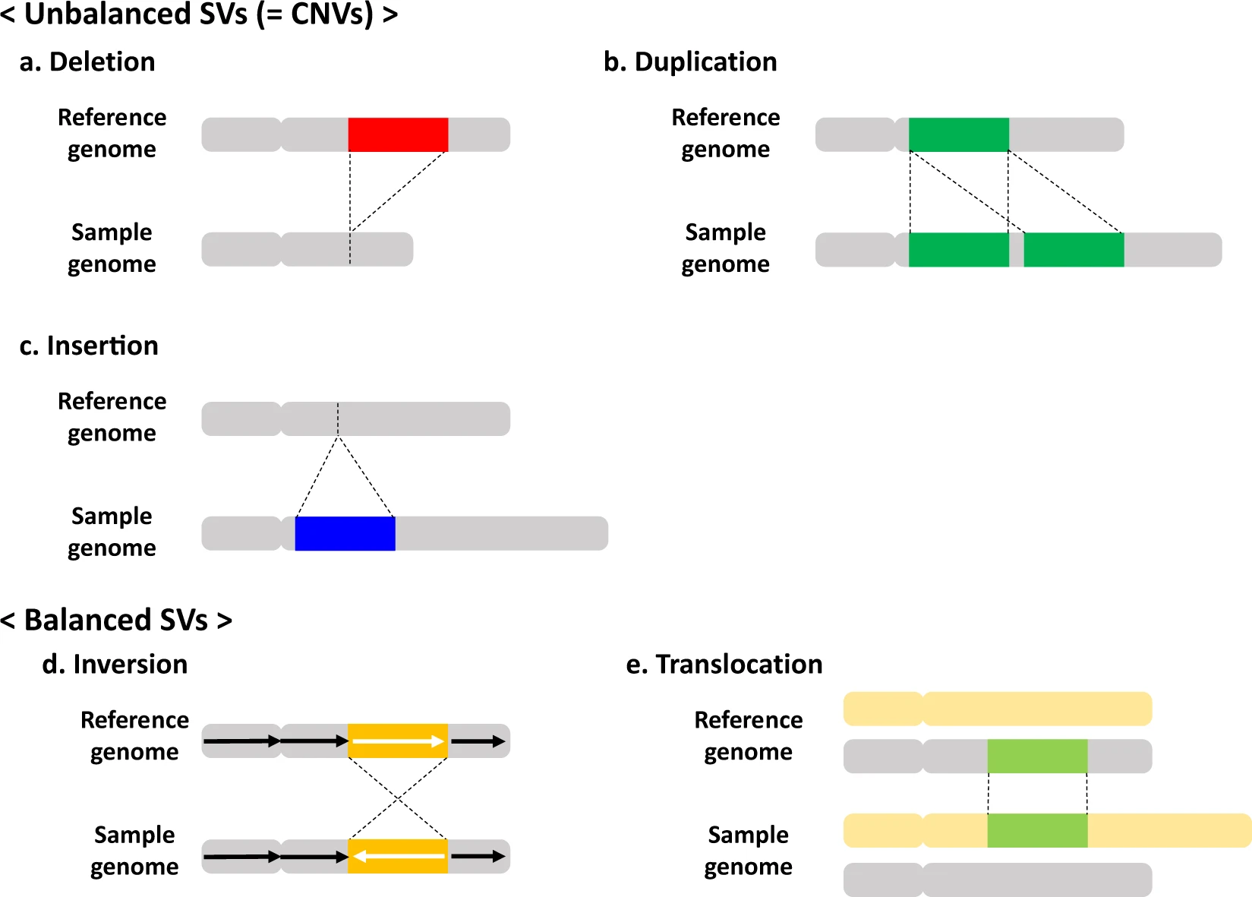
Types of somatic genetic variation
Type of variation | Description | Visualization
Short variants | Single Nucleotide Variants (SNVs) Short Insertions or Deletions (Indels) (2bp- 1Kb)
Unbalanced SVs | Somatic Copy Number Alterations (SCNAs) - copy number gain/loss (Session 7)
Balanced SVs | Structural Variants (SVs): large insertion/deletion, inversion, translocation, tandem/dispersed duplication (Session 6)
SNV
Indel
Short variant (SNVs and Indels) discovery and analyses will be the main focus of today’s session

Slide 7
Framework for short variant discovery (GATK)
Notes:
Next we will discuss different frameworks aka pipelines for short variant discovery. These are basically recommended steps for pre-processing and identifying short somatic variants.

Slide 8
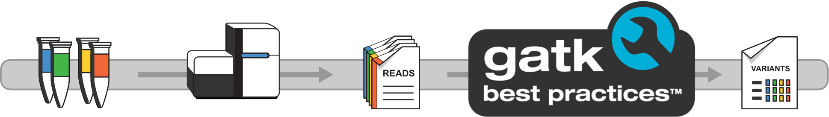
Framework for short variant discovery (GATK)
Developed by the Broad Institute: https://gatk.broadinstitute.org/.
Industry standard framework/pipeline for identifying somatic and germline short-variants.
GATK workflow is expanding to include SCNAs and SVs.
Also includes various tools to perform processing and QC
Designed mostly for WES and WGS Illumina data, but could be adapted to other technologies.
GATK Best Practices
Step-by-step recommendations for processing and analysis from raw reads to variant discovery in high-throughput sequencing.
Notes:
For this, we would like to introduce the GATK (Genomic Analysis Tool Kit) framework developed by the Broad Institute. It is one of the most popular framework/pipelines for processing from raw sequencing reads to identifying short somatic and germline short variants. The workflow is also expanding to include SCNAs and SVs too. In addition, it also includes various tools for processing and performing QC, designed mostly for WES and WGS Illumina data but could be adapted to other technologies too.
Their recommended pipeline is called the GATK Best Practices, which provide step-by-step recommendations for processing and analysis steps required from raw reads to variant discovery analysis in high-throughput sequencing.
One of the great things about GATK is that it is still being actively developed and supported and is free to use. There are active forums that one could ask help for troubleshooting

Slide 9
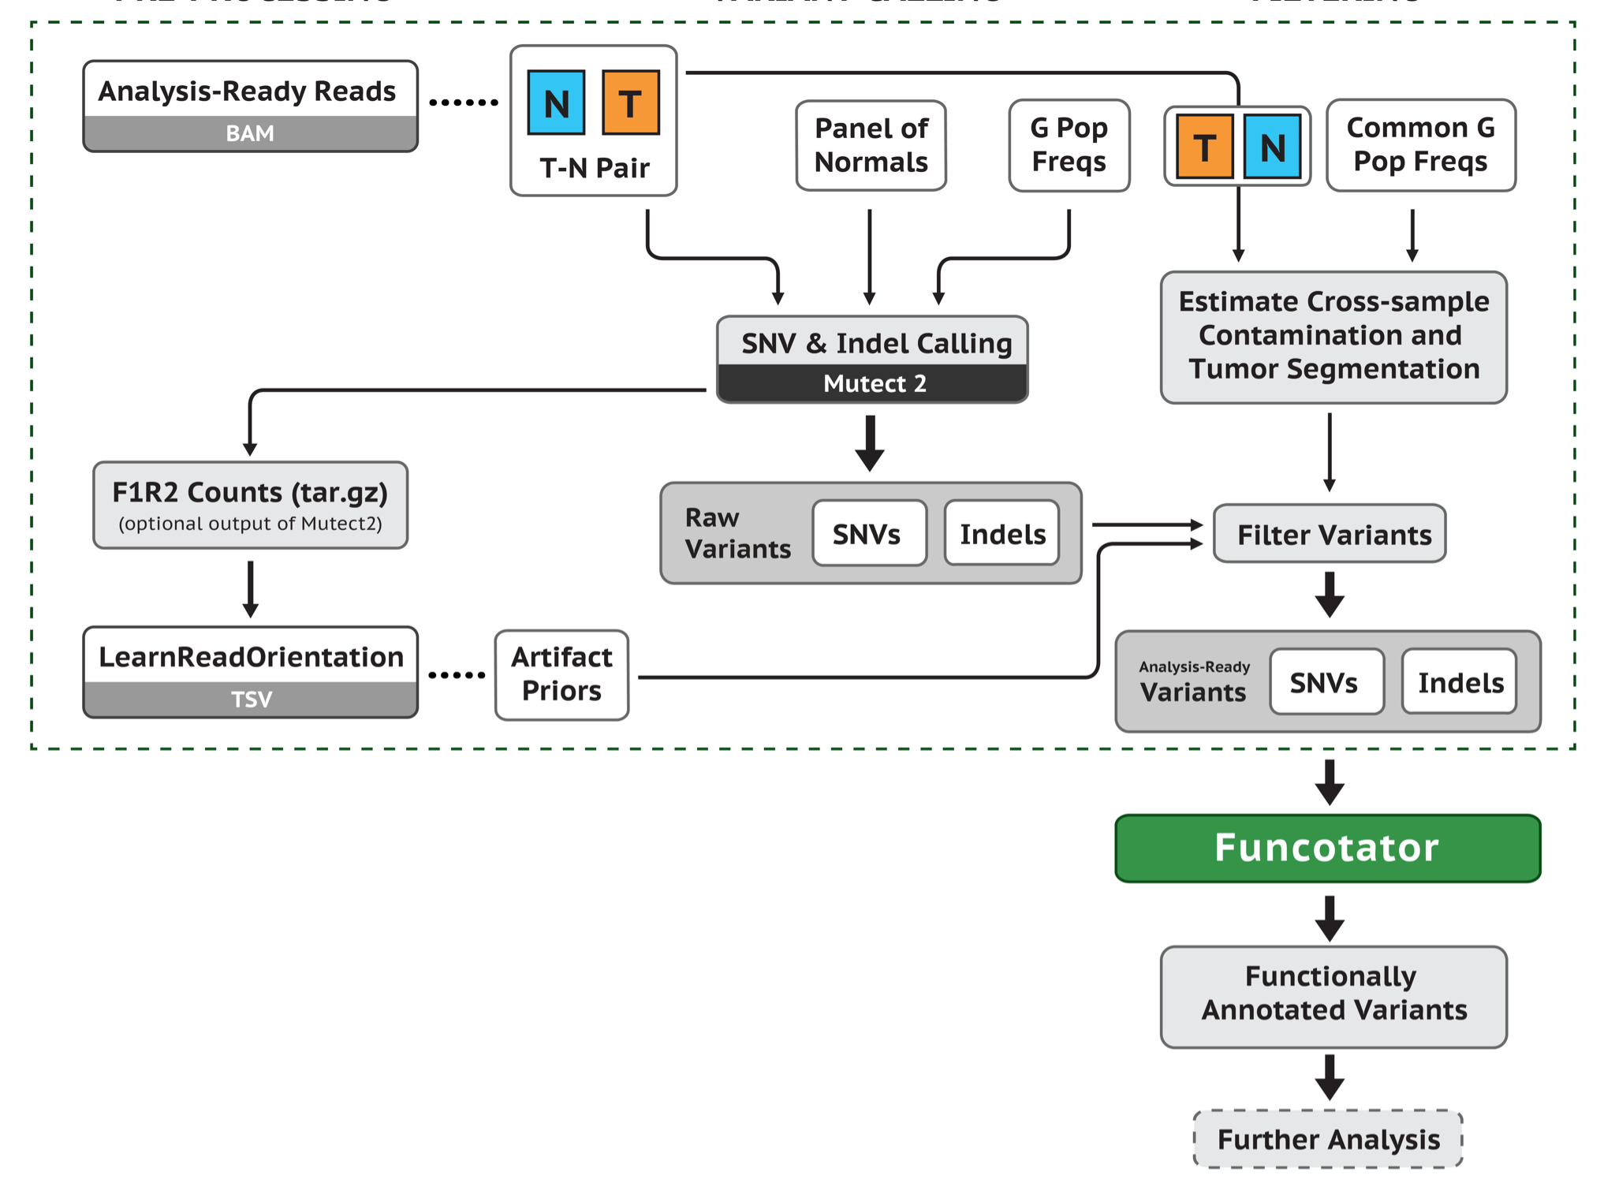
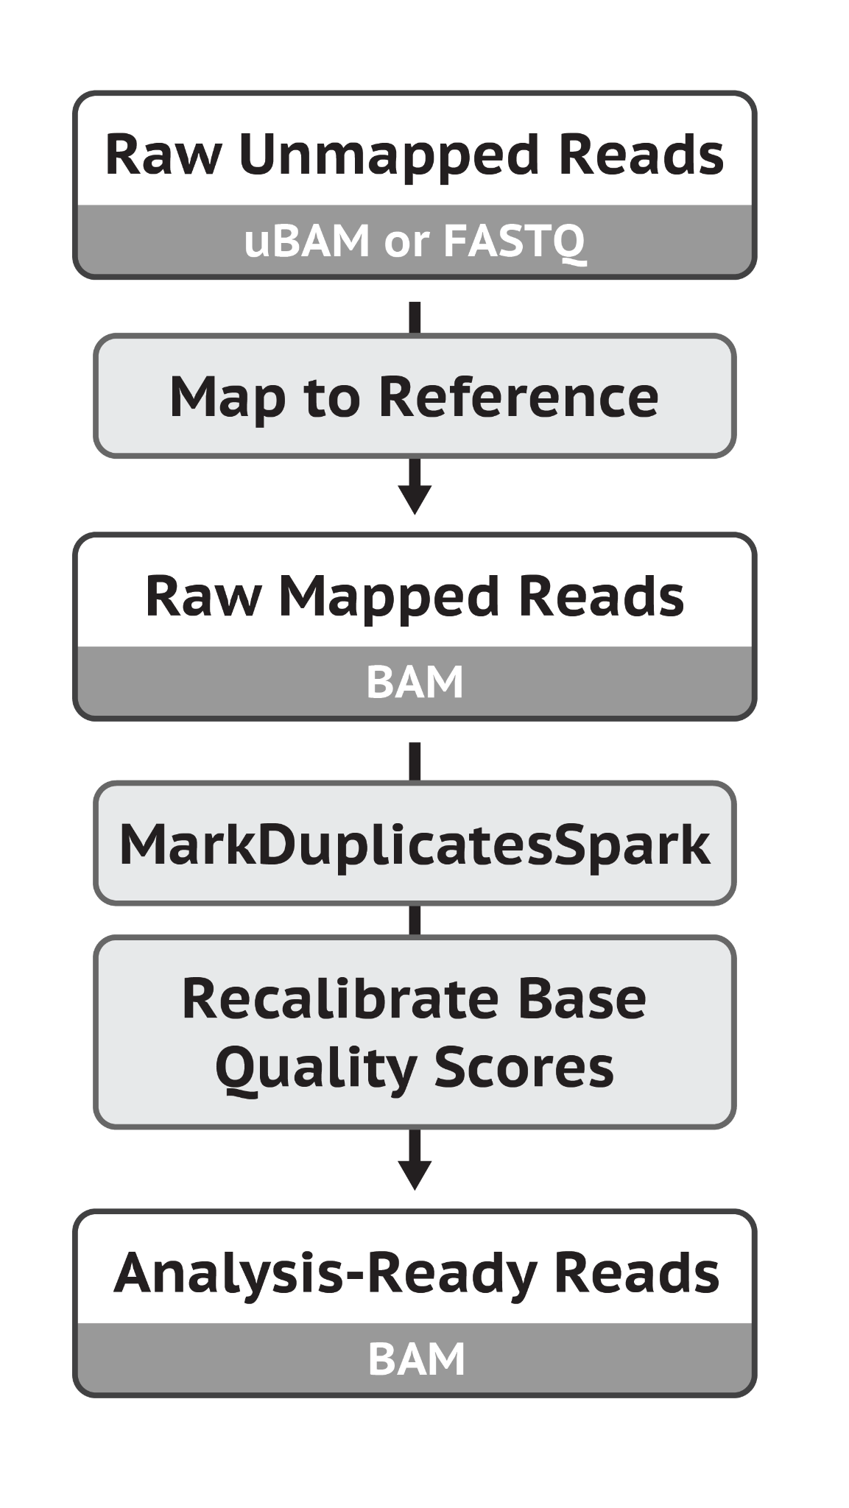
GATK somatic short variant discovery pipeline
Data preprocessing
Variant discovery workflow
Notes:
Here is an overview of the GATK pipeline, consisting of the data pre-processing and the variant discovery steps. After the pre-preprocessing steps, one would go from the unmapped reads to obtain the analysis-ready bam files, which are ready to enter the GATK short somatic variant discovery pipeline depicted here. GATK has its own somatic variant algorithms called Mutect 2, which can call SNVs and indels. This step usually requires a matched T/N pair, and additional information to enable more accurate variant calling such as PoN and Germline Population Frequency. From Mutect2 output, you would get raw variants that would need to be filtered further including for artifacts, cross-sample contamination. GATK then also provides a tool called Funcotator to functionally annotate variants e.g. variant classification, affected gene, associations to data source (e.g. GENCODE, dbSNP, gnomAD, and COSMIC, etc.). You could take these variants for additional filtering steps or downstream analysis.

Slide 10
GATK - Data preprocessing for variant discovery
MarkDuplicatesSpark:
Identifies and marks duplicates leaving only one read unmarked (lecture 3)
Sorts reads into coordinate-order
Marked read pairs are ignored during variant discovery
Recalibrate Base Quality Scores:
Base quality scores are confidence scores emitted by the sequencer for each base
Aid in weighing the evidence for or against possible variants
Systematic quality score bias can occur during library prep and sequencing
Recalibrated with machine learning to correct patterns of systematic bias
BWA
Notes:
In this slide, I would like to highlight a few important steps in in data preprocessing. In the data pre-processing steps, the raw unmapped reads (in FASTQ or uBAM format) are mapped to a reference genome to generate BAM files. These BAM files then undergo additional processing steps call MarkDuplicatesSpark and Recalibrate Base Quality Scores.
If you recall from lecture 3, PCR amplification during library preparation could lead to multiple copies of the same read that start and end at the same genomic location. These reads if not processed can lead to bias and error for downstream analysis. This is where MarkDuplicatesSpark comes in. It marks read duplicates and sort reads into coordinate order. Marked paired reads are ignored during the variant calling process.
RBQS: As mentioned in lecture 3, base quality scores are confidence scores generated by the sequencer for each base. There could be systematic bias for these scores coming from library preparation, sequencing, manufacturing defects in flowcell chips, sequencer variation, and sequencing chemistry, resulting in over or under estimation of the quality score. These scores are important for variant discovery process as they are used as evidence for or against calling possible variants. Hence, it’s important to correct any systematic bias for these scores. That is the role of the step Recalibrate Base Quality Score, which consists of applying machine learning method to detect and correct for patterns of systematic errors in the base quality scores.
https://gatk.broadinstitute.org/hc/en-us/articles/360035535912

Slide 11
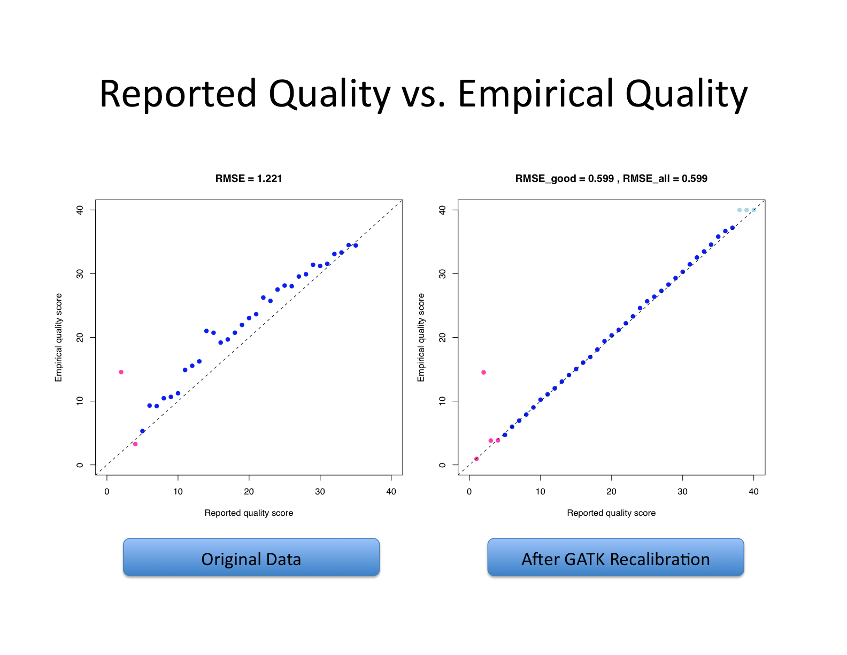
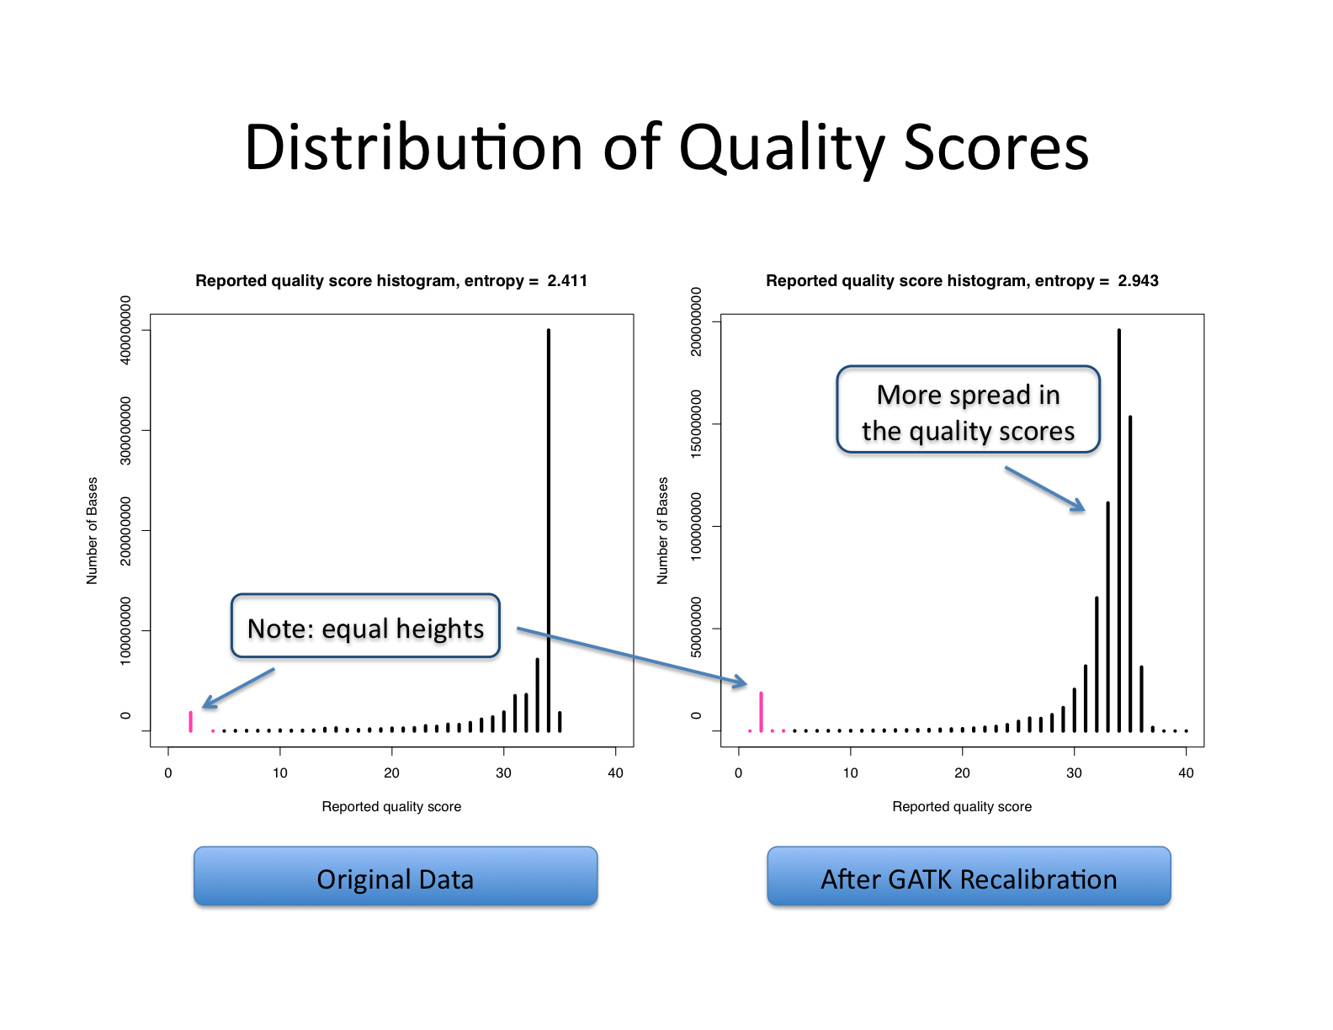
Effects of base quality score recalibration
Empirical Quality Score vs. Reported Quality Score
Distribution of quality score
From GATK
Notes:
Here are just some examples from GATK showing the effects of Base quality score recalibration step. For the left figures, after recalibration, the reported quality scores are much closer to their empirical scores than before. (The empirical quality score vs the reported quality score for a number of bases before and after GATK recalibration)
On the figure on the right, you could see that before recalibration, there seemed to be a systematic bias leading to a peak in base quality score of 34 here. After GATK recalibration, there is a more evenly spread of the quality scores distribution, which is what usually expected
https://github.com/broadinstitute/gatk-docs/blob/master/gatk3-methods-and-algorithms/Base_Quality_Score_Recalibration_%28BQSR%29.md
https://pubmed.ncbi.nlm.nih.gov/26920804/
https://pubmed.ncbi.nlm.nih.gov/27716037/

Slide 12
Panel of Normals (PoN)
Used to capture recurrent technical artifacts
Common criteria for PoN:
Derived from normal samples
As technically similar as possible to the tumors (e.g. same sample preparation methods, sequencing technology, etc.)
Recommended min. 40 samples
Usually from blood
Ideally young, healthy individuals with low chance of having undiagnosed cancers
Public GATK PoN:
Hg38: gs://gatk-best-practices/somatic-hg38/1000g_pon.hg38.vcf.gz
Hg19/b37: gs://gatk-best-practices/somatic-b37/Mutect2-exome-panel.vcf
Notes:
Here I just want to highlight the importance of using PoN for somatic variant calling. The purpose of PoN is to capture recurrent technical. As the name suggests, they are derived from normal samples, usually from blood of young healthy individuals with low chance of having undiagnosed cancers, and the recommended minimum number of samples from GATK are 40. Since they are used to capture technically artifacts, ideally they should be as technically similar as possible to tumors.
It’s not always possible to generate PoN for a specific study. In such case, one could obtain a set of public PoN provided by GATK. The links are provided here.

Slide 13
Learn Orientation Bias Artifacts & Cross-sample Contamination
LearnReadOrientation:
Particularly important for FFPE and Illumina Novaseq samples
Filters oxidation and deamination artifacts with higher frequency in one read pair orientation.
Read more about sequencing artifacts here
CalculateContamination:
Calculate fraction of reads coming from cross-sample contamination
Notes:
In this slide, I would like to highlight the importance of LearnReadOrientation Bias Artifacts and Cross-Sample Contamination Steps in GATK pipeline. For LearnRead Orientation, this step is particularly important and highly recommended for FFPE and Illumina Novaseq samples. It helps filter out oxidation and deamination artifacts with higher frequency in one read pair orientation. (For instance, it helps filter out variants with specific strand orientation in that G > T errors always presented in the first Illumina read, whereas the C > A errors were always found in the second read.)
We have included here a reference where you can learn more about this type of artifact.
For Calculate contamination, this step basically calculates fraction of reads coming from cross-sample contamination. And this information can be used to filter out additional artifacts.
(In this step, F1R2 counts are optional output from Mutect2, which contains the Count of read pairs in the F1R2 and F2R1 configurations supporting the reference and alternate alleles.
F1R2 means first read forward and second read reverse strand. F2R1 means first read (left most) reverse and second read forward
Conversion of Guanine to 8-oxoG which can pair with C and A
Specific strand orientation in that G > T errors always presented in the first Illumina read, whereas the C > A errors were always found in the second read.)
https://pubmed.ncbi.nlm.nih.gov/23303777/

Slide 14
Variant callers
Notes:
Next we will discuss about different algorithms to identify short somatic variants

Slide 15
Somatic variant calling methods - SNVs/indels
Algorithm Class | Details | Example Callers
Heuristic approaches | Apply heuristics to filter sequencing errors Use simple statistical tests to filter somatic variants from germline (e.g. fisher exact test of tumor vs normal VAF) | VarScan2, qSNP, Shimmer, RADIA, SOAPsnv, VarDict
Bayesian approaches | Evaluate the Bayesian probability of a true variant given estimated sequencing error rates, somatic and germline mutation rates, etc. | MuTect, Strelka, EBCall, deepSNV, SomaticSniper, FaSD-somatic, SAMtools, JointSNVMix2, Virmid, SNVSniffer, Seurat, CaVEMan, LoFreq, MuSE
Haplotyping approaches | de novo genome assembly around mutation sites Allows for detection of larger indels + sensitive calling in areas with high mutation density | MuTect2, Strelka2, Platypus, HapMuC, LocHap, FreeBayes, TNscope
Machine learning approaches | Use machine learning to distinguish true somatic variants from germline or artifacts Needs a training set of true somatic variants or ensemble voting from other callers | MutationSeq, SomaticSeq, SNooPer, BAYSIC
Notes:
There are multiple algorithms available for short somatic variant calling with different approaches employed by them. In general, they can be broadly divided into different algorithm class: heuristic, bayesian, haplotyping, and machine learning approaches.
The heuristic approaches, adopted by VarScan2 and VarDict, identify potential variants whose supporting reads meet certain thresholds and then apply statistical tests or ad hoc rules to isolate somatic variants. (For instance, VarScan2 requires at least two supporting reads and 8% VAF for a potential SNV. VarScan2 then applies Fisher's exact test on the 2 × 2 contingency table of read counts (reference vs. non-reference and tumor vs. normal) to help filter out non-somatic variants. Heuristic is a technique to produce a solution in a reasonable time frame that is good enough for solving the problem at hand. This solution may not be the best of all the solutions to this problem, or it may simply approximate the exact solution)
Others like MuTect, Strelka, CAVEman employ Bayesian approaches, in which they evaluate the Bayesian probability of a true variant given various factors including rates of sequencing errors, somatic and germline mutation rates. Sites with higher probability or somatic score are more likely to be identified as somatic variants.
For haplotyping approach employed by popular tools like Mutect2, Strelka2, TNScope, involving de novo genome assembly around mutation sites. It is a widely used approach by many structural variant callers hence it allows for detection of larger indels and sensitive calling in areas with high mutation density
Machine learning approach uses machine learning methods for variant calling, which is essentially a classification problem to distinguish between true somatic variants and germline or artifacts. Different classifiers could be used such as random forest, logistic regression. This approach usually needs a training set of true somatic variants or use ensemble voting from other callers.
Xu C. A review of somatic single nucleotide variant calling algorithms for next-generation sequencing data. Comput Struct Biotechnol J. 2018;16:15-24. Published 2018 Feb 6. doi:10.1016/j.csbj.2018.01.003 https://www.ncbi.nlm.nih.gov/pmc/articles/PMC5852328

Slide 16
GATK - Somatic variant caller Mutect2
Mutect2 currently can call somatic SNVs and indels in 3 modes:
1) Tumor with matched normal (joint calling of multiple tumors/normals from the same individual supported)
2) Tumor-only (additional filtering by functional significance by Functotator is recommended)
3) Mitochondrial
Notes:
The somatic variant caller current used in the GATK pipeline is Mutect2, which can call somatic SNVs and indels in 3 modes.
Calling somatic variants in mitochondrial genome require specific mode as there are different challenges for mitochondrial genome variant calling for instance:
Circular genome - breakpoint by the reference genome is artificial and breakpoint is in the control region (non-coding) and highly variable across individuals, sensitive to variants in the region to capture genetic diversity
Frequently insert into the autosomal human genome - make mapping difficult
Most mitochondrial are normal - variants are only present in low heteroplasmy. Sensitivity can be difficult to achieve
High depth coverage can overwhelm variant callers not designed to handle it
https://github.com/broadinstitute/gatk-docs/blob/master/blog-2012-to-2019/2019-03-05-New!_Mitochondrial_Analysis_with_Mutect2.md?id=23598

Slide 17
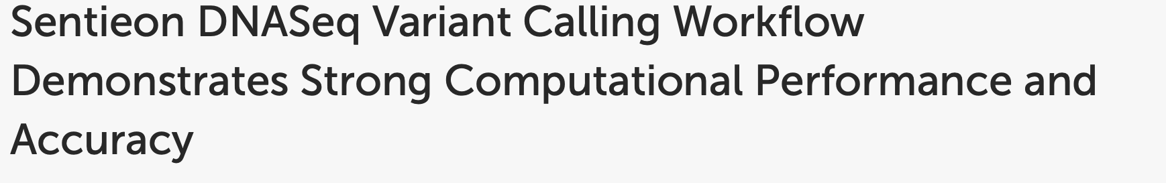
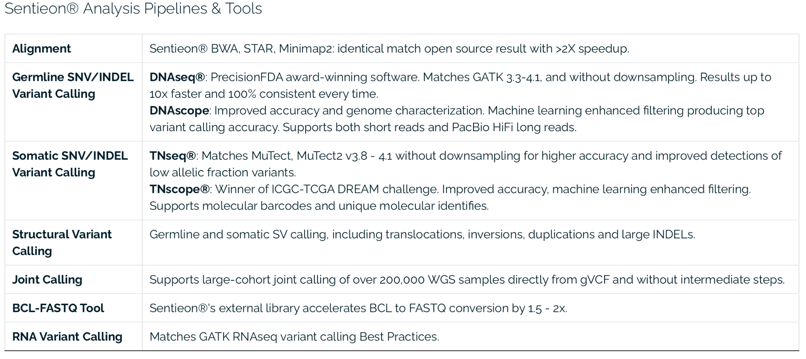
Sentieon genomics tools (commercial)
Kendig et al. 2019, Front. Genet
https://www.sentieon.com/
Notes:
We talked in a lot more details about GATK pipeline, which is free and widely available. I also want to mention here Sentieon, which is an award winning commercially developed set of genomic tools. Their pipeline incorporates multiple well known pipeline for DNA and RNA-seq analyses such as BWA-mem, GATK, STAR, Picard, etc. but they also have their own set of tools (such as TNscope to call somac variant calling) or improve existing pipeline to increase running speed, accuracy and consistency such as Sentieon BWA with faster speed, TNseq that match Mutect2 with improved accuracy. With faster turnaround time, it could potentially help to reduce computing cost compared to available free existing pipelines.

Slide 18
Popular somatic SNV/Indel callers
Name | Types of detection | Paired Normal Requirement | Panel of Normals (PoN)
MuTect2¹ | SNVs, Indels | Somatic tumor-only possible using PoN | Supported
VarScan2² | SNVs, Indels | Required for somatic filtering | No
Strelka³ | SNVs, Indels | Required | No
CaVEman⁴ | SNVs | Required | Supported
LoFreq⁵ | SNVs, Indels | Required for somatic filtering | No
VarDict⁶ | SNVs, Indels | Required for somatic filtering | No
MuSE⁷ | SNVs | Required | No
TnScope/TnSeq (Sentieon, commercial)⁸ | SNVs, Indels | Somatic tumor-only possible using PoN | Supported
NeuSomatic⁹ | SNVs, Indels | Required | No
Variant callers with tumor-only modes could potentially be useful for study without matched normal (additional downstream filtering is often recommended)
These algorithms may work with PacBio, though somatic benchmarking is lacking
Notes:
In this table here, I summarize a few popular somatic variant callers and highlight a few key differences. They could be different in terms of what types of variants they are able to detect. Most are able to detect both SNVs and indels, but some for instance CaVEman developed by the Sanger and MuSE can only detect SNVs for now. Most of them require matched T/N pairs for somatic mutation calling, but some can call somatic variants with a PoN for downstream additional filtering. (VarScan, Vardict, and LoFreq can call mutations in a tumor file alone but do not distinguish germline from somatic in that case).
In terms of sequencing platforms supported by different variant callers, most if not all support Illumina sequencing. Ion Torrent technology could have high false-positive rate with variant callers, an ensemble approach considering results from multiple callers is strongly recommended, particularly with deep sequencing: https://bmcmedgenomics.biomedcentral.com/articles/10.1186/s12920-019-0636-y
Most callers could perhaps support PacBio LRS since it now has similar accuracy as Illumina - however, there has not been an extensive benchmark or official recommendation for somatic long read sequencing analysis.
Cibulskis K., Lawrence M.S., Carter S.L., Sivachenko A., Jaffe D., Sougnez C (2013). Sensitive detection of somatic point mutations in impure and heterogeneous cancer samples. Nat Biotechnol. Available from GATK: https://gatk.broadinstitute.org/hc/en-us
Koboldt, D., Zhang, Q., Larson, D., Shen, D., McLellan, M., Lin, L., Miller, C., Mardis, E., Ding, L., & Wilson, R. (2012). VarScan 2: Somatic mutation and copy number alteration discovery in cancer by exome sequencing Genome Research DOI: 10.1101/gr.129684.111. Available at: http://dkoboldt.github.io/varscan/ .
Kim, S., Scheffler, K. et al. (2018) Strelka2: fast and accurate calling of germline and somatic variants. Nature Methods. doi:10.1038/s41592-018-0051-x . Available at: https://github.com/Illumina/strelka
Jones D, Raine KM, Davies H, Tarpey PS, Butler AP, Teague JW, Nik-Zainal S, Campbell PJ. cgpCaVEManWrapper: Simple Execution of CaVEMan in Order to Detect Somatic Single Nucleotide Variants in NGS Data. Curr Protoc Bioinformatics. 2016 Dec 8;56:15.10.1-15.10.18. doi: 10.1002/cpbi.20. PMID: 27930805; PMCID: PMC6097605.
Wilm A, Aw PP, Bertrand D, Yeo GH, Ong SH, Wong CH, Khor CC, Petric R, Hibberd ML, Nagarajan N. LoFreq: a sequence-quality aware, ultra-sensitive variant caller for uncovering cell-population heterogeneity from high-throughput sequencing datasets. Nucleic Acids Res. 2012 Dec;40(22):11189-201. doi: 10.1093/nar/gks918. Epub 2012 Oct 12. PMID: 23066108; PMCID: PMC3526318.
Lai Z, Markovets A, Ahdesmaki M, Chapman B, Hofmann O, McEwen R, Johnson J, Dougherty B, Barrett JC, Dry JR. VarDict: a novel and versatile variant caller for next-generation sequencing in cancer research. Nucleic Acids Res. 2016 Jun 20;44(11):e108. doi: 10.1093/nar/gkw227. Epub 2016 Apr 7. PMID: 27060149; PMCID: PMC4914105.
Fan, Y., Xi, L., Hughes, D.S. et al. MuSE: accounting for tumor heterogeneity using a sample-specific error model improves sensitivity and specificity in mutation calling from sequencing data. Genome Biol 17, 178 (2016). https://doi.org/10.1186/s13059-016-1029-6
TnScope: https://www.biorxiv.org/content/10.1101/250647v1.full.pdf
TnSeq:
Neusomatic: https://www.nature.com/articles/s41467-019-09027-x
TnScope and TnSeq

Slide 19
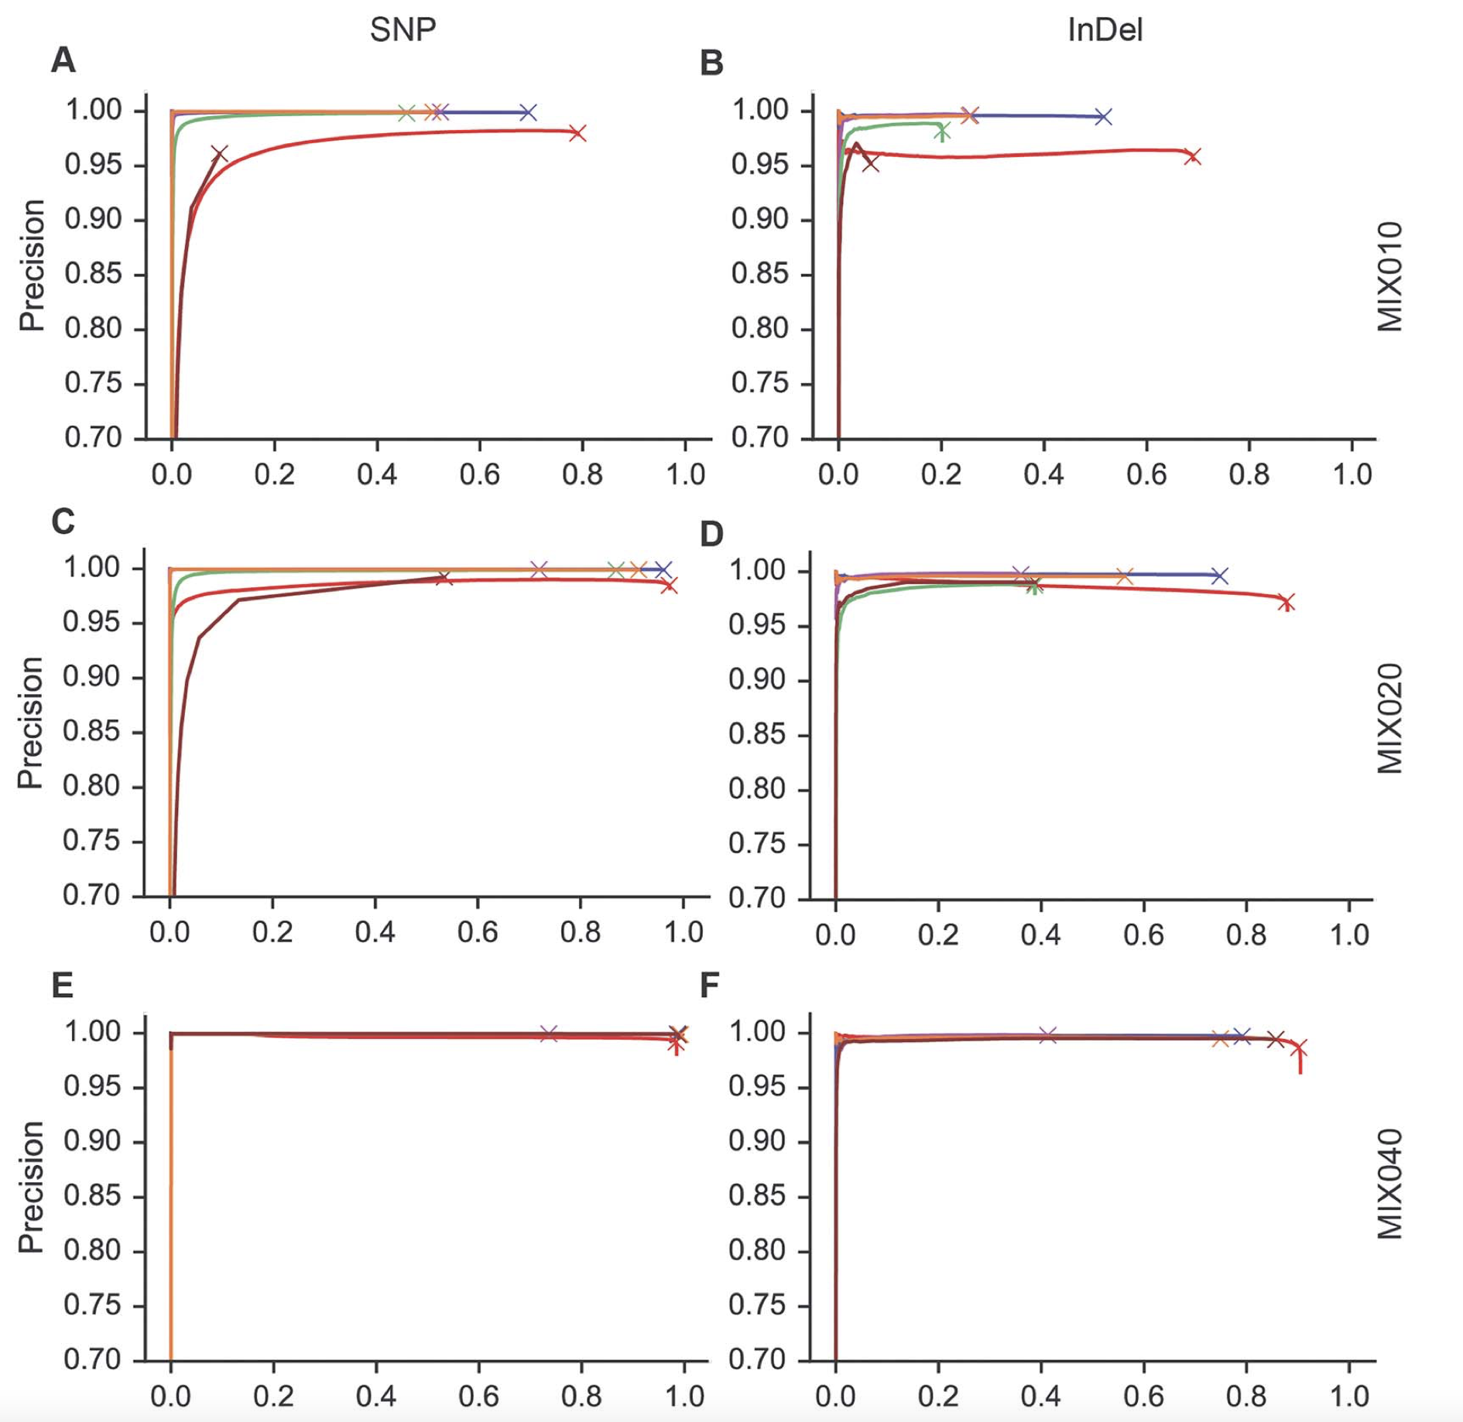
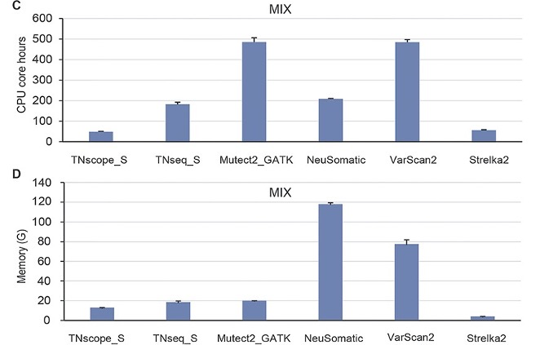
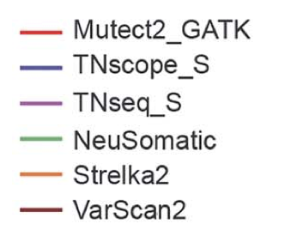
Benchmarking somatic variant callers
Precision-recall curves with different mixed tumor ratios
Computational cost of different callers
Precision
Tumor purity affects variant calling accuracy and sensitivity
Sentieon TNscope and GATK Mutect2 have best recall, particularly at low purity
TNscope also has low computing resource usage
Recall
Pei et al. 2020, Brief Bioinform
Notes:
So how do different variant callers perform relatively to each other. Here we include results from one of the most recent benchmarking papers comparing various tools - Mutect2, Strelka2, VarScan2, Neusomatic, and TnScope and TnSeq from Sentieon. On the left hand side showing precision and recall of different callers at various tumors mixed ratio (e.g. Higher mixed ratio here means higher tumor purity). As you can see, sample purity do affect the precision and recall rate of all variant callers to certain extent, especially at low sample purity. Overall, MuTect2 and TnScope perform consistently better than other variant callers with higher precision and recall rate across different tumor purity.
In terms of computational cost, Sentieon TnScope does have relatively low CPU core hours and memory consumption compared to others. So even though Sentieon is not a free software, the cost licence could potentially be offset by the lower computational cost.
https://academic.oup.com/bib/article/22/3/bbaa148/5875142
https://bmcgenomics.biomedcentral.com/articles/10.1186/s12864-022-08365-3 : Aligners could also lead to different accuracy

Slide 20
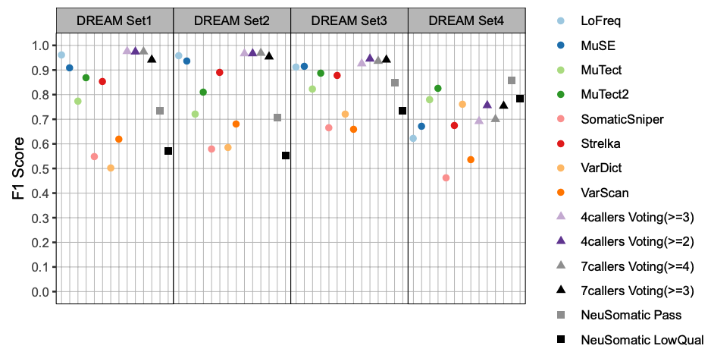
An ENSEMBLE approach:
Example of somatic variant calling pipeline by CGR
Substantial discrepancies exist among the calls from different callers
Multiple variant callers needed in pipeline
Somaticseq2
https://github.com/NCI-CGR/somatic-conda
Somatic-combiner
https://github.com/mingyi-wang/somatic-combiner
A consensus ensemble approach which can combine somatic variants generated from seven popular callers:
LoFreq, MuSE, MuTect2, MuTect, Strelka, VarDict and VarScan.
Wang et al. 2020, Sci Rep
Notes:
With so many variant callers available, the question is which variant caller to use? Very often, there are substantial discrepancies existing among the variant calls from different callers. Therefore, most of the time multiple variant callers are needed in a pipeline. Just to give you an example, to this end, our very own CGR developed a somatic variant calling pipeline consists of two parts: Somaticseq2: to call somatic variants using different somatic variant callers. This is then followed by Somatic-combiner: A program to make ensemble call based upon the output from somaticseq2.
The work has been published in Scientific reports in 2020. The benchmark (using the DREAM dataset) demonstrated that the ensemble calls (made from somatic-combiner) outperform the individual callers in general. F1 score here is the weighted mean of precision and recall.

Slide 21


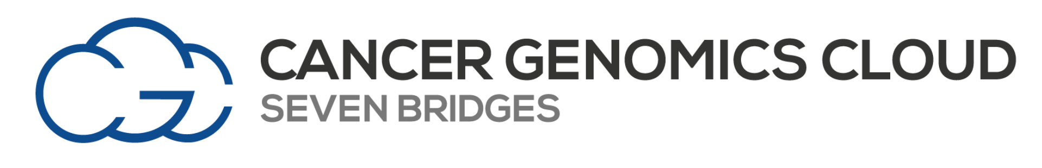
NCI Cloud resources for somatic variant calling
NCI Cloud Resources are components of the NCI Cancer Research Data Commons (see lecture 2).
Eliminate the need to download and store extremely large datasets.
Hosts large datasets such as TCGA, TARGET, Human Cell Atlas.
Selected somatic short variant workflows from NCI Cloud resources:
Strelka
VarDict
VarScan
GATK
Other variant calling (germline, SVs, SCNAs), multi-omics and imaging workflow also available.
Notes:
Instead of running your somatic variant pipeline on the HPC, there is an emerging interest to run these analyses on the Clouds, which could eliminate the need to download and store extremely large datasets. Here I would like to mention a few NCI Cloud resources available for somatic variant calling, as part of the NCI Cancer Research Data Commons that was mentioned in lecture 2. They are based on different cloud platforms so you could choose one that suits your preferences. For instance, FireCloud is a Broad Institute project powered by Terra (which is a cloud platform developed by the Broad Institute, and Microsoft). ISB-CGC uses Google Cloud Platform so it includes many Google native tools and technologies (including Google BigQuery for big data analytics and Google Compute Engine for complex workflow execution). Cancer Genomics Cloud is powered by Seven Bridges platform.
In general, they all cover common somatic variant workflows such as Strelka, Vardict, VarScan, GATK, and other variant calling pipelines for germline, SVs, SCNAs, RNA-seq, methylation, and imaging, etc.

Slide 22
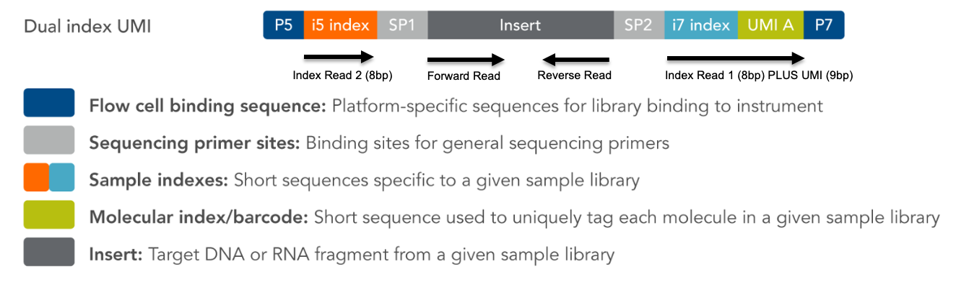
Mutation Calling with Unique Molecular Identifiers (UMIs)
Figure courtesy of CGR
UMIs
9-base sequences embedded in the adapter sequence of all CGR library prep. UMI is unique per molecule prior to DNA amplification
Intended for error-correction
Reads from the same molecule are collapsed into a single consensus read
An analytical choice of whether to use UMIs, requires very deep coverage (>500 - 1000x)
Due to cost, mostly used for targeted sequencing
Can improve sensitivity of low frequency calls (<5%)
Notes:
Next we will discuss more about the use of Unique Molecule Identifiers (or UMIs) to improve sensitivity of calling somatic variants present in a lower fraction of the cells (<5%).
First of all, UMI is a molecular level barcode, consisting of 9-base sequences, and embedded in the adapter sequence and incorporated during the adapter ligation step of all CGR library prep. UMI is unique per molecule prior to amplification.
UMI is intended for error-correction: reads from the same molecule are collapsed into a single consensus read and can correct for later-stage PCR and sequencing errors when multiple copies of the same molecule are sequenced. However, it will not correct for early-stage PCR errors or DNA damage
Although UMI is incorporated into all CGR library prep, it is an analytical choice of whether to use UMI as it often requires very deep coverage and distinct pipeline for data preprocessing and variant calling.

Slide 23
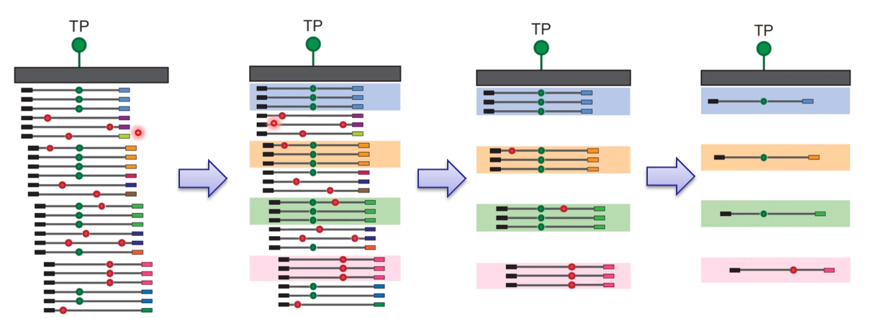
UMIs for error correction
Figure courtesy of CGR
If the start/stop sites of multiple read pairs are the same and they have the same UMI tag, they are identified as duplicates.
Only molecules that have multiple read pairs are kept
Singleton read pairs are discarded, reducing final coverage for variant calling.
Many late-stage PCR errors and sequencing errors can be eliminated, reducing noise.
Because of the reduction in errors, true low frequency variants are more readily called.
Notes:
In this slide we will discuss more about how UMI works. In this figure let’s say green is the position of true positive variant. Red indicates artifact or false positive variants from late-stage PCR errors and sequencing errors.
After PCR duplication, If the start/stop sites of multiple read pairs are the same and they have the same UMI tag, they are identified as duplicates - as highlighted here.
Only molecules that have multiple read pairs are kept. Singleton read pairs are discarded, reducing final coverage for variant calling. Therefore, we do need high coverage to begin with.
These duplicates are removed but to keep one copy that contains variants supported by multiple reads. Therefore, many late-stage PCR errors and sequencing errors can be eliminated, reducing noise. Because of the reduction in errors, true low frequency variants are more readily called.

Slide 24
Variant filtering & annotation
Notes:
In the next section we will share knowledge on Variant filtering and annotation.

Slide 25
Somatic variant filtering
To remove potential artifact signals caused by sequencing platform, alignment software, and incomplete or complex nature of reference genomes.
[GATK - FilterMutectCalls ]
To remove potential contaminated signals from germline variants.
[Germline Population Variant Database (PVDs) ]
FilterMutectCalls
Friendly Reminder: Raw reads preprocessing & Somatic variant calling & Filtering & Annotation will be shown in the later practical session. Welcome!
Notes:
Although most of the somatic variants callers have been constantly updated for several years and now with high positive rate, sometimes they may still produce low quality data. That is why after somatic variant calling, strict variant filtration is always required before further analysis. Usually there are two categories for Somatic Variant filtering. (1) To remove potential artifact signals caused by sequencing platform, alignment software, and the artifact signals due to incomplete/complex nature of reference genomes. (2) The second aim is to remove potential contaminated signals from germline variants. The first category usually requires well-designed algorithms like FilterMutectCalls. While the second category requires several public germline population variant database PVDs. (3) Here is a Reminder: in the later practical session of this morning, we will show you the whole GATK somatic variant calling process, including raw reads preprocessing, somatic variant calling, somatic Variant filtering and the Variant annotation. If you are interested to see how this will work at practical level, welcome to join us!

Slide 26
Commonly used tags for somatic variants filtering
Filtering Tags | Description
alt_allele_in_normal | filter out variants with enough evidence as being present in the paired normal sample
germline_risk | filter out variants that show sufficient evidence of being germline variants based on Population Variant Databases
homologous_mapping_event | filter out variants with more than three events present nearby, as they are usually indicative of false-positive calls
clustered_events | filter out variants linked to multiple events present on the same haplotype as they are usually indicative of false-positive calls
str_contraction | filter out variants which are contraction of short tandem repeat
Strand Bias Events | filter out variants which locates only in one strand (Forward/Reverse)
low_t_alt_frac | filter out variants with low alternate allele fraction in tumor sample
(URL: https://support.sentieon.com/appnotes/out_fields/ )
Friendly Reminder: in the next IGV visualization and validation section, detailed examples of the common filtered events
Notes:
In the somatic variant filtering processes, there are several contents that need to be taken into consideration. Here we list several most commonly used items for somatic variants filtering. In your own VCF file, you can always find these filterings, it's very useful to know, what's their meaning. There are also some other filtering items, for the detailed information, please check the link below. Here is another Reminder: in the next IGV visualization and validation section, detailed examples of the main filtering will be presented. You will get the opportunity to see what these examples look like.

Slide 27
Common population databases for germline-based filtering
Databases | Description | Filtering criteria suggestions | Links
The 1000 Genomes Project | Germline SNPs and SVs from >3200 individuals covering 25 populations | population specific MAF (Minor Allele frequency) <0.1%. | https://www.internationalgenome.org/
ESP | Germline mutations from the NHLBI Exome Sequencing Project. | population specific MAF <0.1%. | https://evs.gs.washington.edu/EVS/ Biowulf: /fdb/annovar/current/hg38/hg38_esp6500siv2_all.txt
gnomAD v2 | Germline mutations from 125,748 whole exomes and 15,708 whole genomes | population specific MAF <0.1%. | https://gnomad.broadinstitute.org/ Biowulf: /fdb/gnomad/release-2.0/
gnomAD v3 | Germline mutations from 76,156 whole genomes | population specific MAF <0.1%. | https://gnomad.broadinstitute.org/ Biowulf: /fdb/gnomad/release-3.0/
Notes:
Here, we list several useful population variant database for germline based filtering, including the 1000 genome project, ESP and gnomAD. Here, we strongly suggest you to use gnomAD, as the gnomAD almost include the germline variants from the other two variants. In these database, variants with population specific MAF<0.1% are usually suggested to keep for further somatic analysis. Here, we recommend you to use gnomad, as gnomad almost include the variants from these two databases above. Of course, users can customize the cutoff by themselves according to their specific project. All the official links of these database are listed here. Of note, Most of these resources are in huge size and will take a long time to download. Good news is that gnomAD data are all pre downloaded in biowulf, as the biowulf users, you can use them directly.

Slide 28
Variant annotation
Variant annotation is the process of collection of detailed information from knowledge bases and publications to interpret a given genomic alteration.
Funcotator is a useful module to provide functional annotation of somatic alterations.
Example annotations: gene name, position, frequency, classification (Intron, UTR, Splicing Site), etc.
Users can add their own annotation sources based on a set of public database resources.
Notes:
Sequencing cancer genome can typically identify thousands of somatic mutations even after strict filtration. These mutations may have different functions: tumor activation, tumor suppression, or no clear functional changes. Variant annotation is the process of collection of detailed information based on existing knowledge to interpret a given genomic alteration. As another important part of GATK ecosystem, funcotator is a very useful module to provide functional annotation of somatic alterations. This tool allows a user to add their own annotations to variants based on a set of data sources. Output for annotation can include a bundent of information: gene name, position, and variant Classification (Intron, UTR, Splicing Siite)

Slide 29
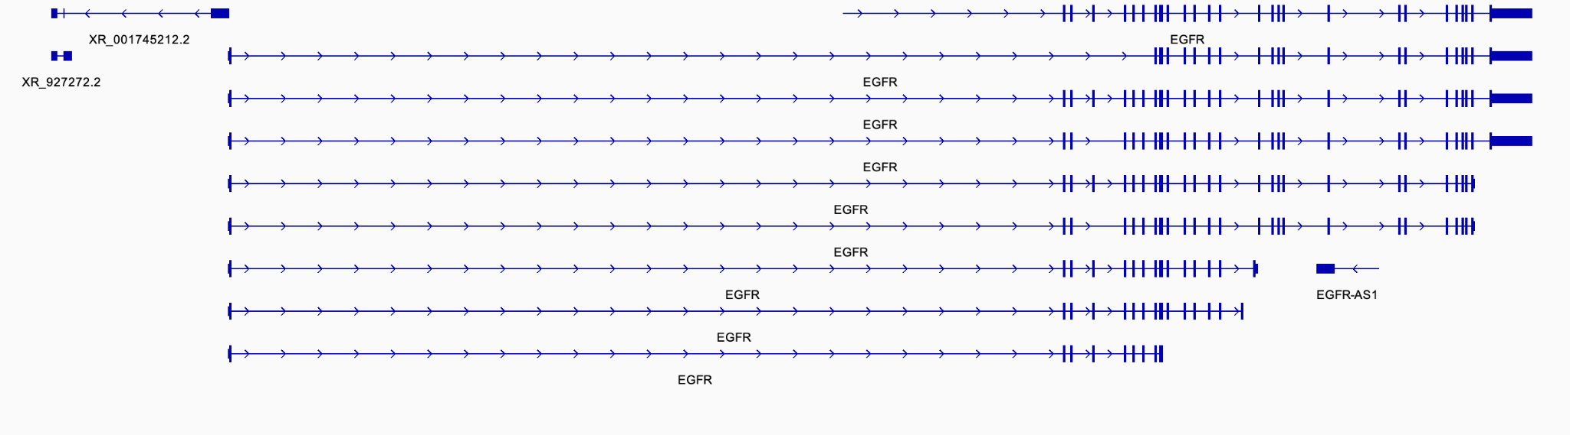
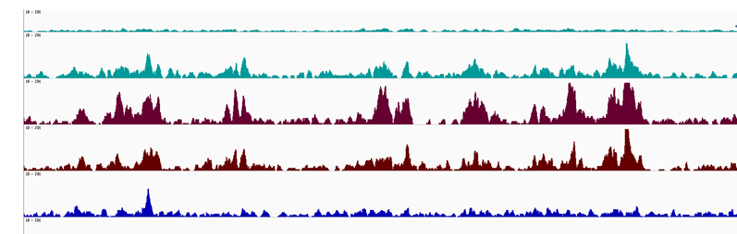
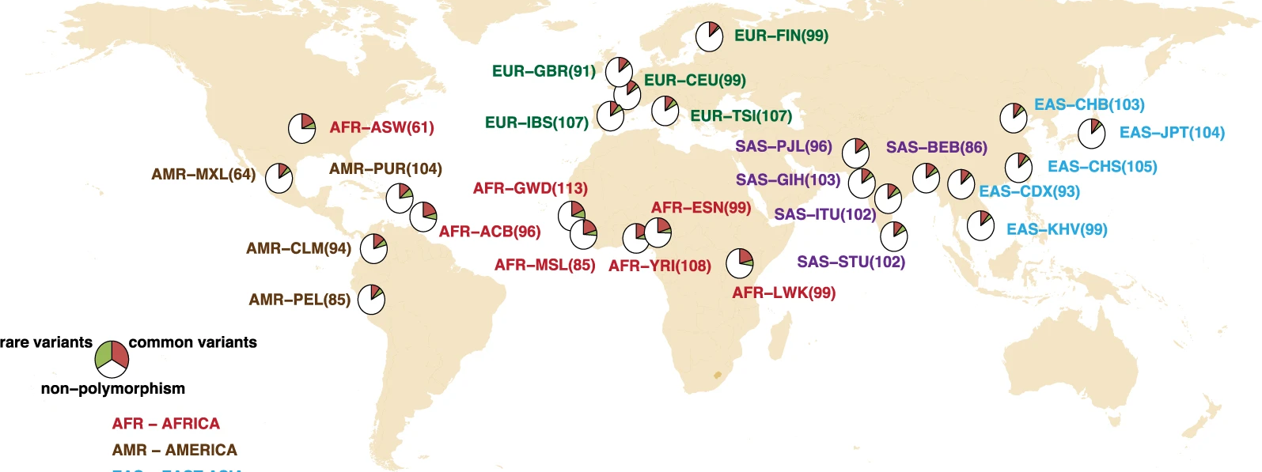
Different strategies of annotations
Gene-based annotation:
Whether a genomic mutation happened in known protein coding / non-coding regions. Users can easily customize their analysis using different public databases with detailed gene annotation information.
Region-based annotation:
Whether a genomic mutation happened in specific genomic elements. For example, Open chromatin (ATAC-seq peaks), Histone mark enrichment (ChIP-Seq peaks), or many other annotations on genomic intervals.
(https://deeptools.readthedocs.io/)
Filter-based annotation:
Whether a genomic mutation is reported in specific cancer databases like cosmic. What is the frequency of this mutation among global populations?
(PMID: 33547344)
Notes:
Here I would like to introduce three kind of level of annotations, which can be very useful for your own project.

Slide 30
Useful resources for variants annotation
Category | Resource | Descriptions | Links
Gene-based annotation | UCSC | Comprehensive annotations at both genes and transcripts levels | https://genome.ucsc.edu/ Biowulf: /fdb/annovar/current/hg38/hg38_refGene.txt
Region-based annotation | ENCODE | Encyclopedia of DNA Elements, including transcription factor binding sites, ChIP-Seq peaks, and ATAC-seq peaks | https://sites.google.com/site/jpopgen/dbNSFP Biowulf: /fdb/annovar/current/hg38/hg38_wgEncodeGencodeBasicV40.txt
Filter-based annotation | COSMIC | Catalogue of somatic mutations in cancer | https://cancer.sanger.ac.uk/cosmic Biowulf: /fdb/annovar/current/hg38/hg38_cosmic92_coding.txt
 | ICGC | Somatic mutations identified by International Cancer Genome Consortium | https://dcc.icgc.org/ Biowulf: /fdb/annovar/current/hg38/hg38_icgc28.txt
 | Clinvar | Catalogue of human variants and phenotypes with supporting evidence | https://www.ncbi.nlm.nih.gov/clinvar/ Biowulf: /fdb/annovar/current/hg38/hg38_clinvar_20220320.txt
(URL: https://annovar.openbioinformatics.org/en/latest/user-guide/download )
Notes:
Here, we list several useful database for variants annotation, which could be very useful for your own project. For example, for gene-based annotation, you can you UCSC genome browser, which can provide .... All the official links of these database are listed here. Similar to the resources used for variant filtering, most of these resources are in huge size and take a lot of time to download. The good news is that all of these data resources have already pre-downloaded in biowulf, as the biowulf users, you can use them directly, just follow the link below.

Slide 31
IGV for visualization and validation
Notes:
Manually checking sequencing reads is an important step for sequencing data analysis, it can greatly increase the confidence in variant calling. In this section we present a short description of using IGV for visualization and validation of identified variants.

Slide 32
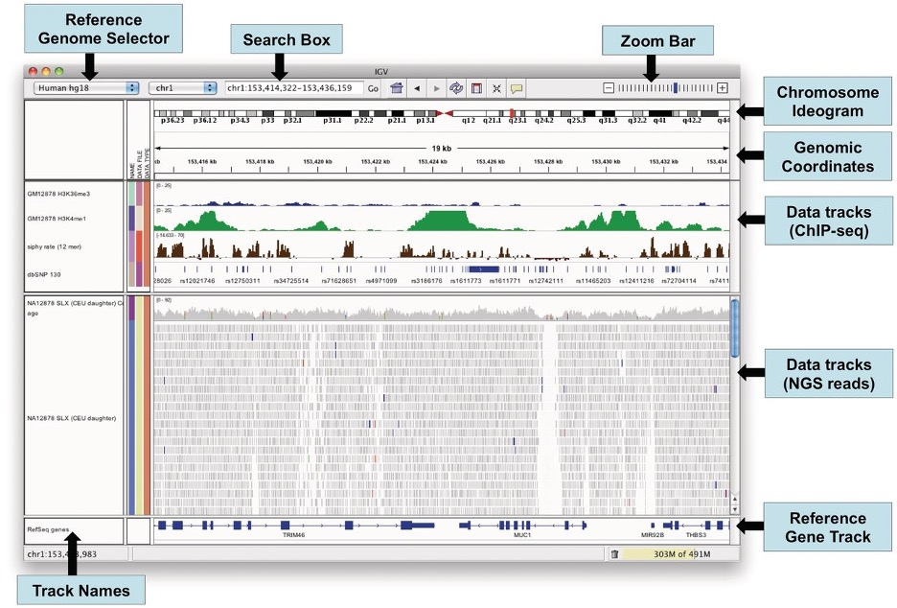
IGV - Integrative Genomics Viewer
Notes:
First, what is IGV? IGV is a high-performance integrative genomic browser which can efficiently handles large scale sequencing datasets. IGV can be used for visualization of various data type, including: genome annotation, Sequencing reads & alignment, Chip-Seq Peaks, genomic coordinates and chromosome ideogram.

Slide 33
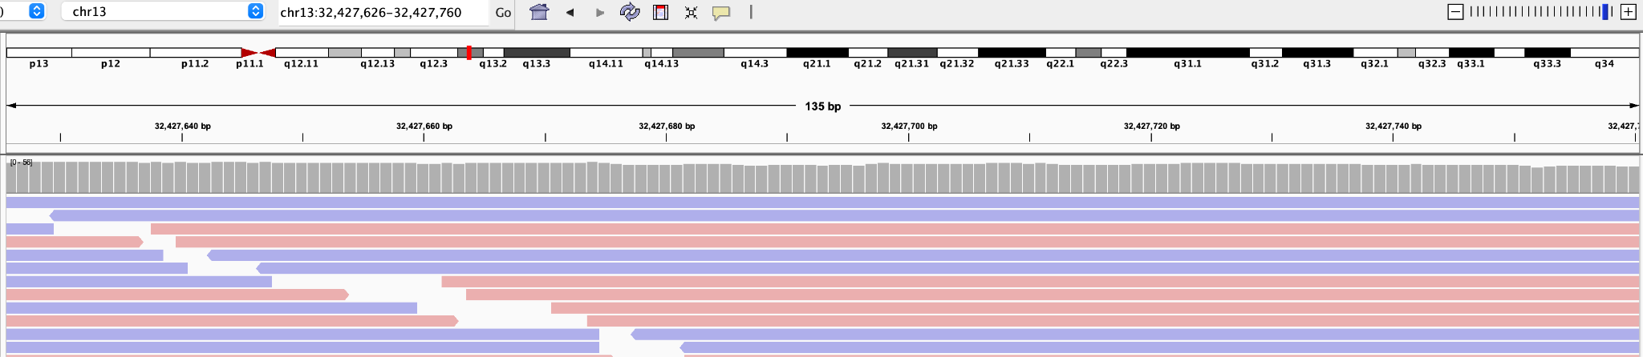
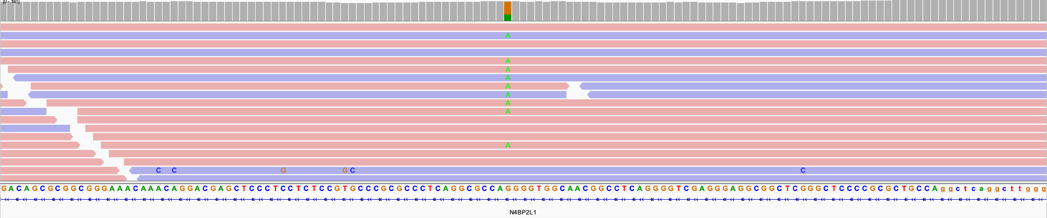
1. Typical Good Examples of SNVs in IGV
Normal
Tumor
A: Green T: Red G: Brown C: Blue
Forward Reads
Reverse Reads
Notes:
IGV uses for different color to represent different nucleotide bases. Green for A, Red for T, Brown for G and Blue for C. The reads in pink color represent Forward Reads, the reads in blue color represent reverse Reads. Let’s see the following example, When we zoom in to this region, of chromosome 13, We can see that in reference genome at this position the base is G. However, when we check our Sequencing data from Tumor, we can find that some reads carries a G>A mutation. This mutation can be supported by both forward and reverse reads. This mutations are found only in Tumor and but not normal samples. The region nearby is very clean, almost no other variants are observed. This is a Typical good example of somatic SNVs reviewed by IGV

Slide 34
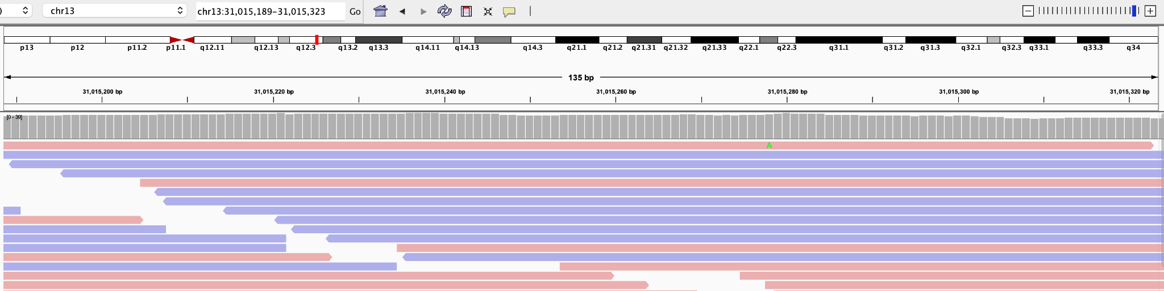
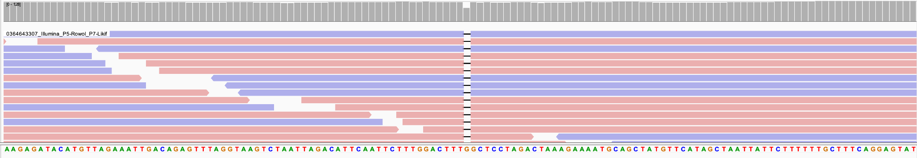
2. Typical Good Examples of Deletion in IGV
Normal
Tumor
Notes:
Let’s see the example of somatic deletion. When we zoom in to this region of chromosome 13, we can see at the Reference genome here, there is a G. however, when we check our sequencing data, we find that some reads with deletion of this G, this deletion can be supported by both forward and reverse reads. The most important thing is that this deletion are found only in Tumor and but not normal samples. The region nearby is very clean, almost no other variants are observed. This is a very good examples of somatic Deletion reviewed by IGV

Slide 35
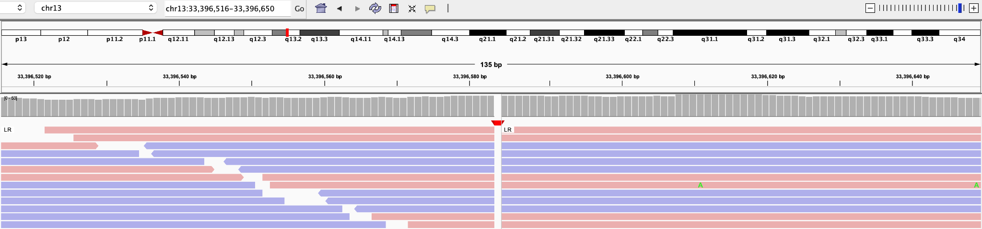
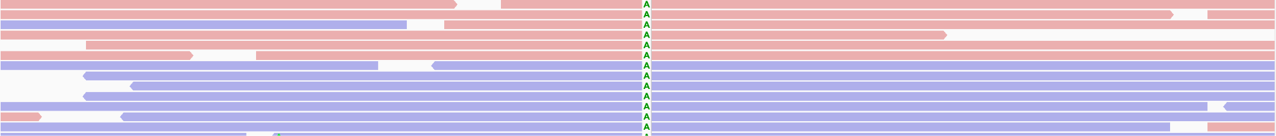
3. Typical Good Examples of Insertion in IGV
Normal
Tumor
Notes:
In the following example, when we zoom in to the position of chr13. We can see that at Reference genome, here is empty, however, when we are checking Sequencing data, we found some reads have an additional of A, these insertion can be supported by both forward and reverse reads. This insertion are found only in Tumor and but not normal samples. The region nearby is very clean, almost no other variants are observed. This is a Typical good examples of somatic insertion events reviewed by IGV

Slide 36
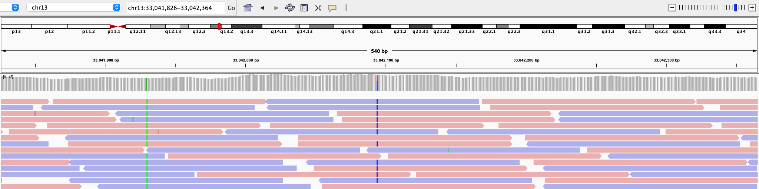
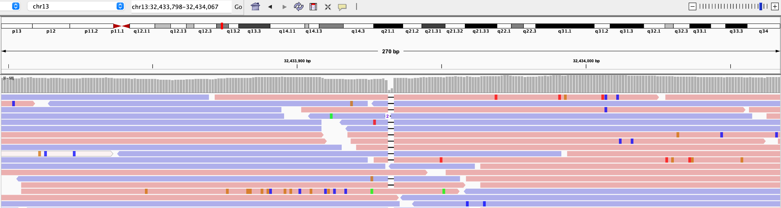
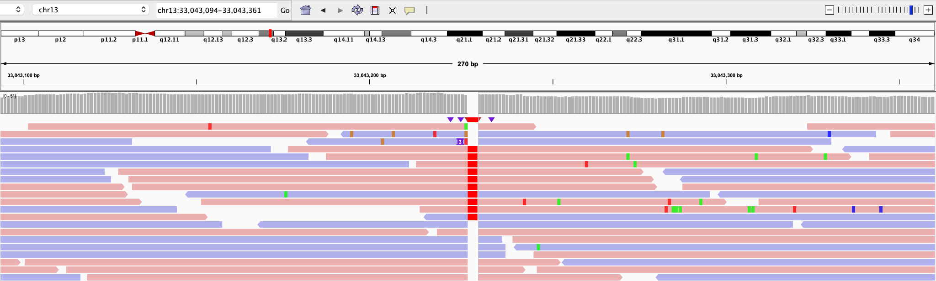
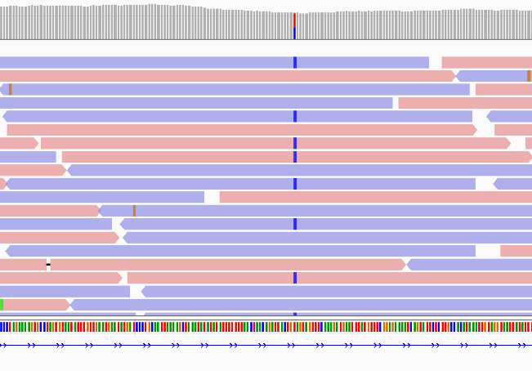
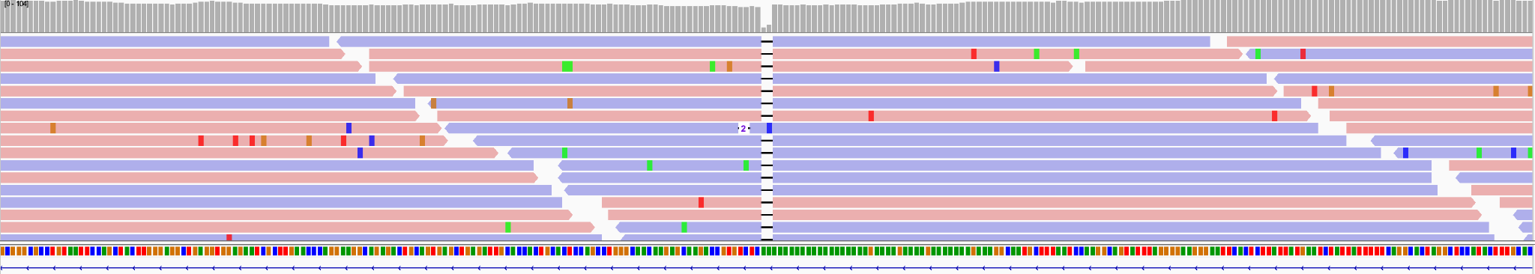
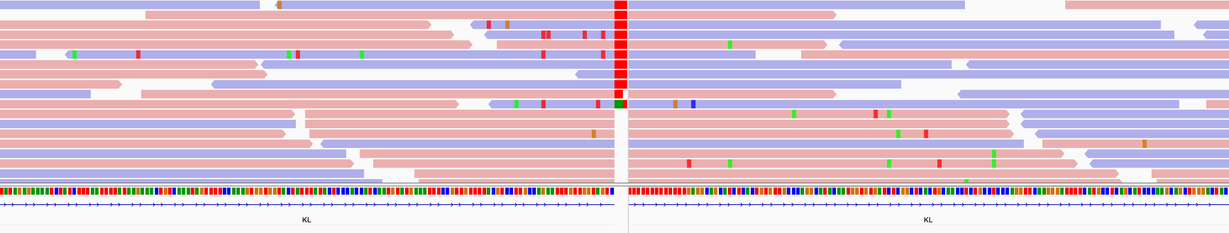
4. Suspicious Mutations - Germline Events
SNV
Deletion
Insertion
Normal
Tumor
Notes:
Now let’s see some suspicious examples. When we zoom in on chr13, we can clearly see some high confidence mutations: on the left is a T>C SNV, in the middle diagram a deletion, and on the right diagram an insertion. The problem is that these mutations are found in both tumor and paired normal samples. So these are actually germline events, which have been rejected by our filtering algorithm.

Slide 37
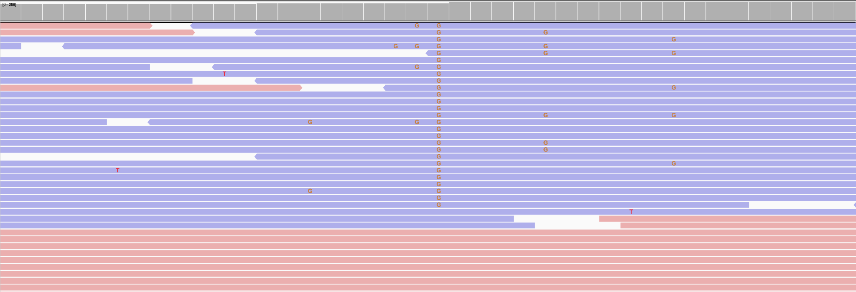
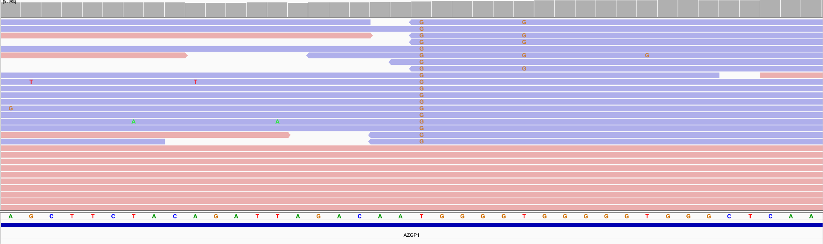
5. Suspicious Mutations - Strand Bias Events
Normal
Tumor

Slide 38
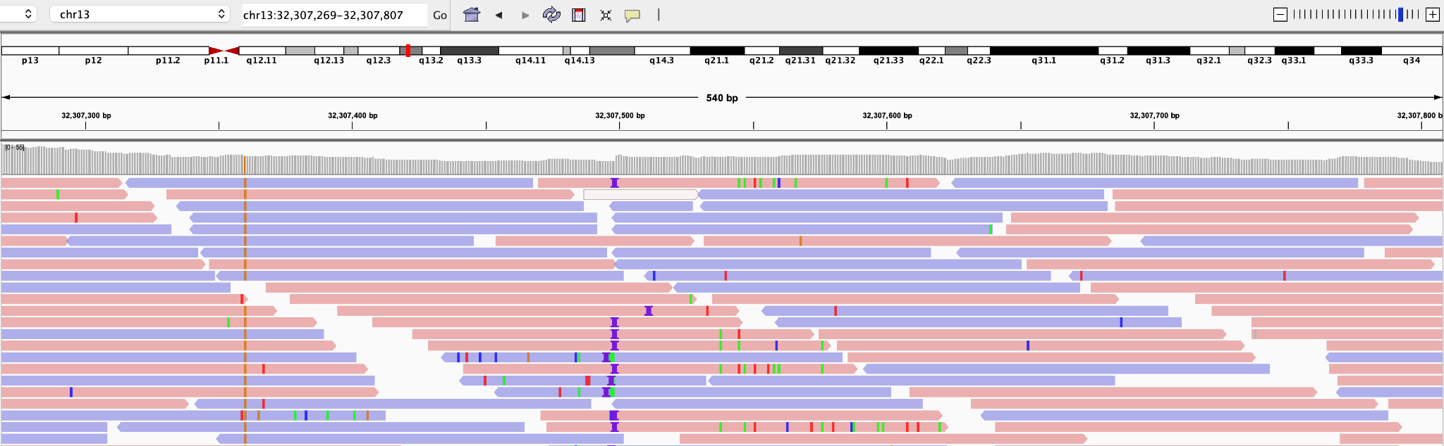
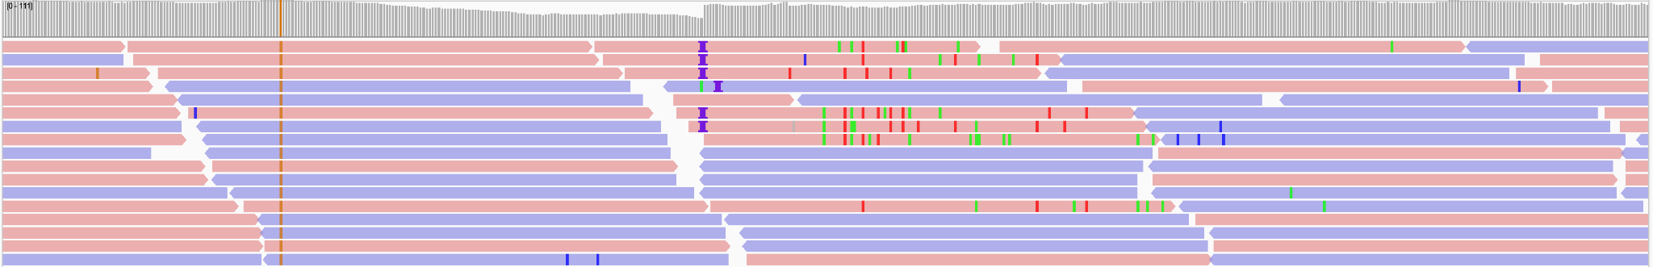
6. Suspicious SNV - Homologous Mapping Event
Normal
Tumor
Notes:
Now let’s see this example, at around this region, there are so many mutations detected by our sequencing data. Our filtering algorithm defined this as Homologous Mapping Event by algorithm. Furthermore, most of these mutation, were found with very Low Alternative Allele Fraction, means that very limited reads support theses mutations, this is an indicative of artifact, and have been rejected by our filtering algorithm.

Slide 39
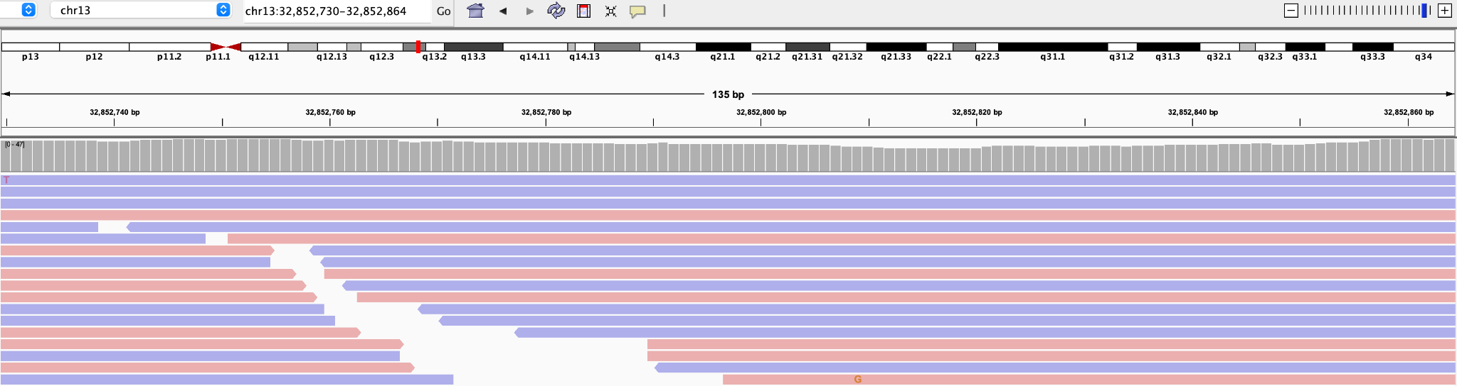
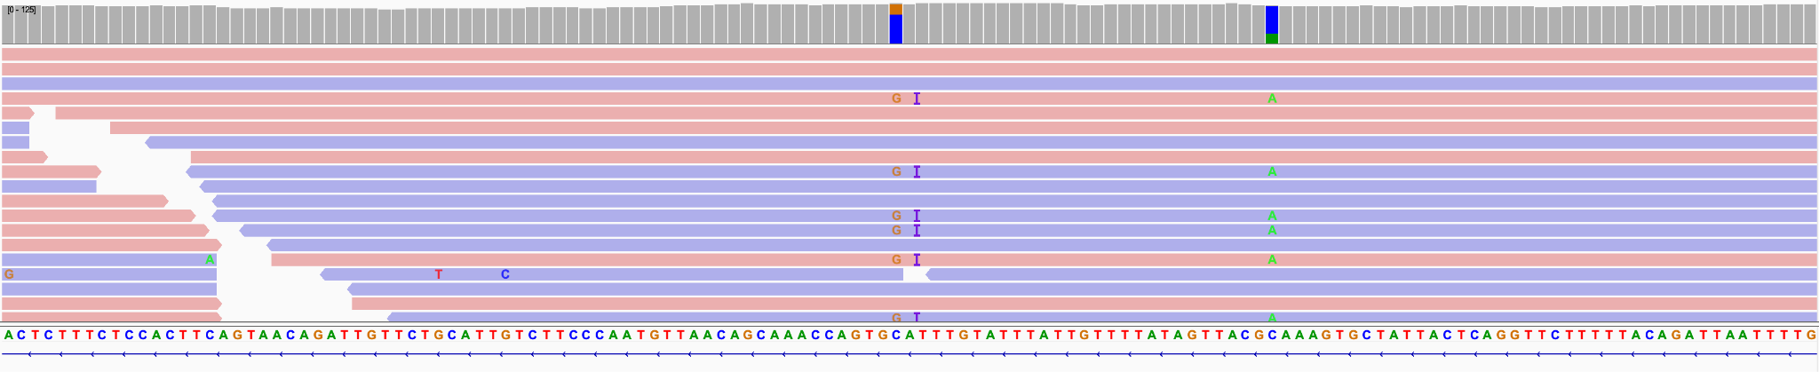
7. Suspicious SNV/Indel - Clustered Events
Normal
Tumor
Notes:
let’s see this example, at around this region, three mutations are identified from our sequencing data. Including A C>G mutation, an insertion and C > A mutation. These mutation are found in only tumor samples but not normal samples. The flanking region are very clean, almost no other event are observed, it looks like they are good examples of somatic mutation events. Howere, they are still rejected by filtering process. As they are observed to be linked with each other in the same haplotype. In somatic data analysis, this phenomenon is called clustered Events, usually when a cluster wans found include more than two events in the same haplotype, there is high possibility that they are artifact for somatic variants, so they are rejected by our algorithms..

Slide 40
Summary - Challenges for accurate somatic variant calling
Not as simple as identifying tumor-specific variants
Challenges | Potential solutions
Artifacts from PCR amplification | Mark or even remove duplications before calling. Increase DNA sequencing library complexity. Utilize UMIs
Machine sequencing errors | Use strict variant hard filtering.
Incorrect local alignment of reads | Perform indel realignment before calling.
Tumor heterogeneity/Low tumor purity | Increase sequencing depth or manually call variants, which allows detection of low VAF variants.
Sequencing depth and read length, DNA library complexity and Insert size | Refer to Session 3 material for solutions.
Tumor-normal cross-contamination | Perform strict BAM-level data QC. Particularly check for any copy number alterations in normal tissue.
Artifacts related to the source materials (FFPEs or alcohol fixed tissue) | Use strict variant filtering and carefully check the VAF, mutational patterns, or known mutations after variant calling. Mutational signature analysis can be used to remove artifacts (e.g. FFPESig).
Complicated genome regions (long repeat region, GC/AT-rich regions, centromere etc.) | Define a blacklist of these regions and try to exclude any variants in this blacklist for downstream analysis.
Notes:
As you have seen from the lectures so far, there are multiple challenges for accurate somatic variant calling - it is not as simple as identifying sites with a variant allele in the tumor and not present in normal.
In this summary table, we listed common challenges and the potential solutions for your reference. We will not have time to go over everything in this slide but I would like to highlight a few examples. For example, to minimize artifacts from PCR amplification, we could mark or even remove duplication before calling, increase DNA sequencing library complexity, and/or utilize UMIs. To improve variant calling for low purity tumors, we can increase sequencing depth and/or manually review/call variants to enable detection of low variant allele frequency variants.

Slide 41
Common somatic mutational analyses

Slide 42
Common somatic analyses (SNVs/Indels)
Ancestry inferred from WGS (not somatic analysis, but very helpful)
Tumor mutational burden (TMB) analysis
Mutational exclusivity analysis
Hotspot mutation analysis
Pathway analysis
Mutational signatures (session 5)
Cancer driver genes (session 8)
Mutation clonality analysis (session 9)

Slide 43
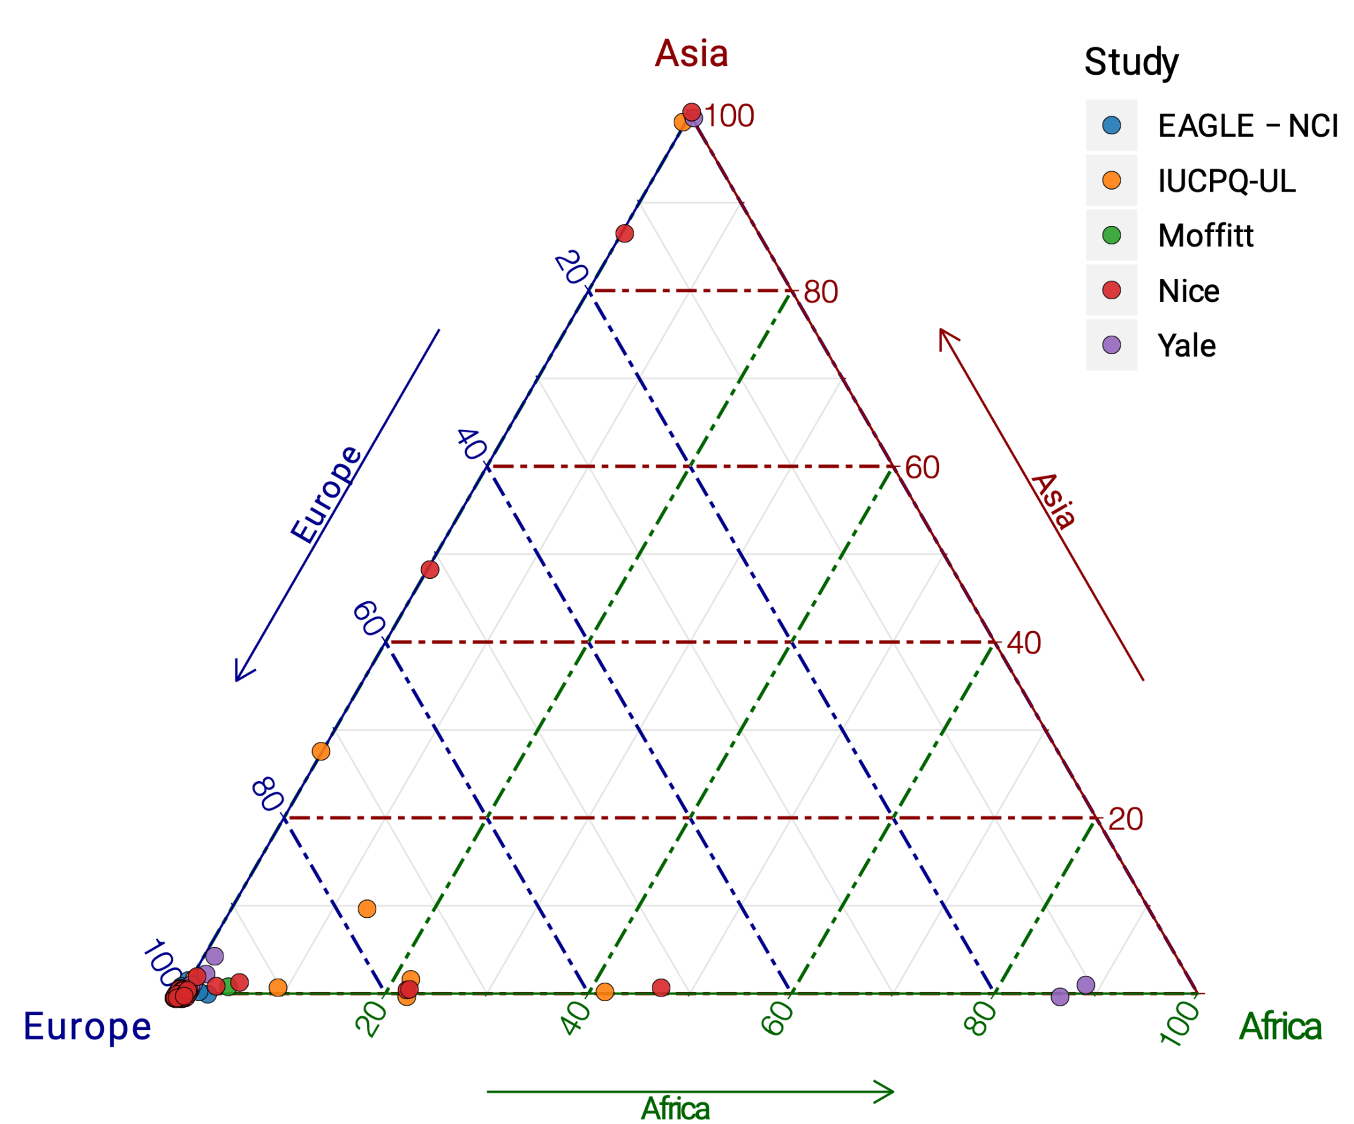
Ancestry inferred from WGS
ADMIXTURE analysis of 232 WGS lung cancer in never smokers (Zhang et al. 2020, Nature Gen)
Notes:
Using WGS, one can infer ancestry of particular individuals. This is not really somatic analysis but is extremely helpful for downstream somatic analysis e.g. To identify race/population specific association somatic mutations or clinical outcomes, etc.
This is a figure from our very own analysis of 232 WGS lung cancer in never smokers, which use ADMIXTURE to infer ancestry. ANCESTRY is a software tool for maximum likelihood estimation of individual ancestries from multilocus SNP genotype datasets. In this example, the majority of the subjects have European ancestry, while a few are Asian and African ancestry and a few have mixed European/Asian ancestry or mixed European/African ancestry.

Slide 44
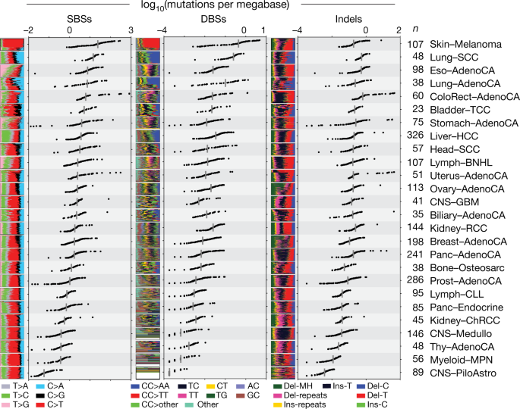
Tumor mutational burden (TMB) analysis
Defined as total number of mutations (usually for short variants) in a cancer genome
TMB is often considered a predictor of prognosis
High TMB is also considered as predictor of immunotherapy response
Figure shows mutational burden across PCAWG tumor types (Alexandrov et al. 2020, Nature)

Slide 45
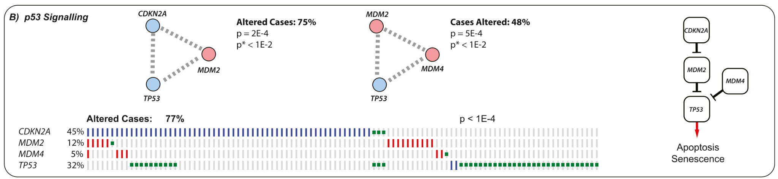
Mutational exclusivity
(Ciriello et al. 2011, Genome Research)
Genetic alterations of a group of genes in the same pathway does not tend to occur in the same sample.
E.g. Mutations in p53 signaling pathways often show mutual exclusivity in glioblastoma.
CDKN2A, MDM2, MDM4, and TP53 are in the same pathway regulating responses to DNA damage/apoptosis, etc.
Functional redundancy hypothesis: The pathway is compromised and apoptosis evaded once one gene is altered. Additional alterations to the pathway do not change the effect on the apoptosis process and are not selected for.
Co-occurrence hypothesis: Alteration to a second gene within the same pathway might lead to a disadvantage for the cell e.g. cell death.
Application: synthetic lethality for therapeutic design. E.g. Targeting both KRAS and EGFR in LUAD
Notes:
Mutational exclusivity analysis could then help identify pathways of group of genes that could be targeted for treatments.
https://genome.cshlp.org/content/22/2/398.full
Visualization by Oncostrip

Slide 46
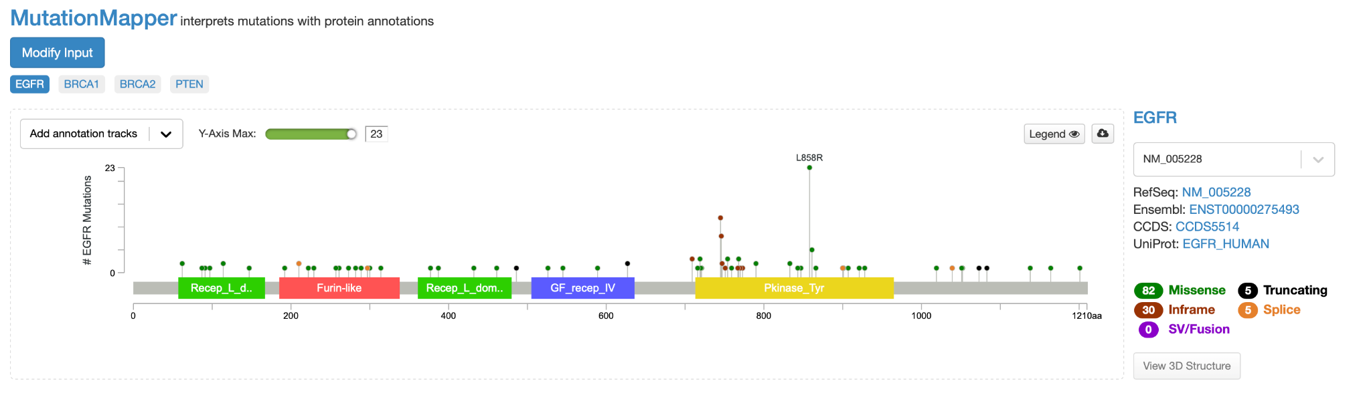
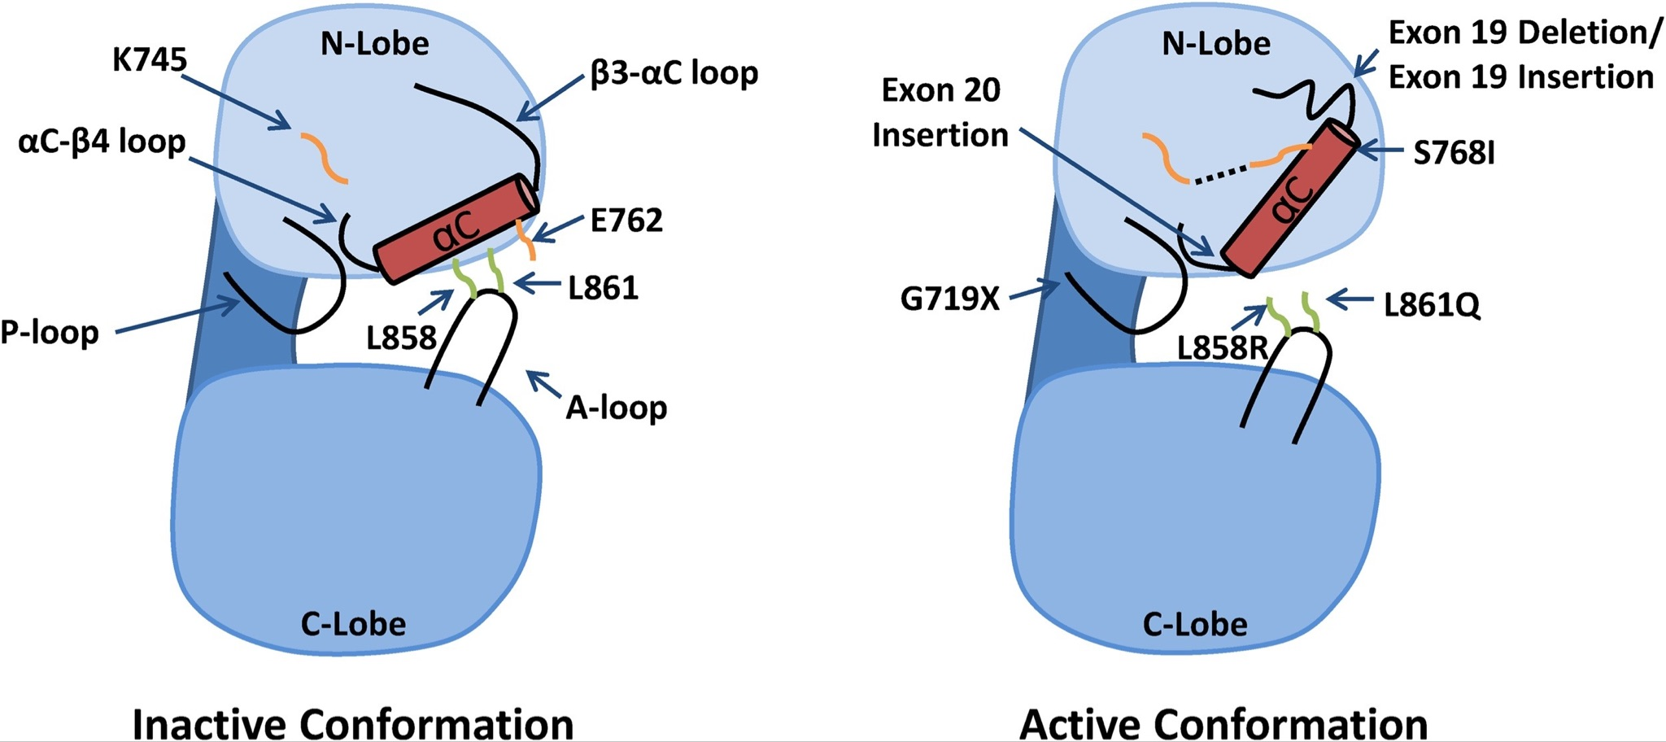
Hotspot mutation analysis
MutationMapper
Harrison et al. 2020
Mutation hotspots can help reveal mutagenic mechanisms, or can reveal information about the functional domains of a target protein.
Could indicate preferential expansions of mutants with high fitness
L858R is a common activating EGFR mutation in non-small cell lung cancer (right figure)
Hotspot mutations occur more frequently in oncogenes than tumor suppressor genes
Notes:
L858 lies within the helical turn of the activation loop and forms crucial hydrophobic interactions with residues in the N-lobe when the receptor is in the inactive conformation
L858R substitution is incompatible with the inactive conformation and therefore “locks” the kinase domain in a constitutively active conformation
Hotspot mutations often occur in oncogene rather and tumor suppressors often occur more sparsely

Slide 47
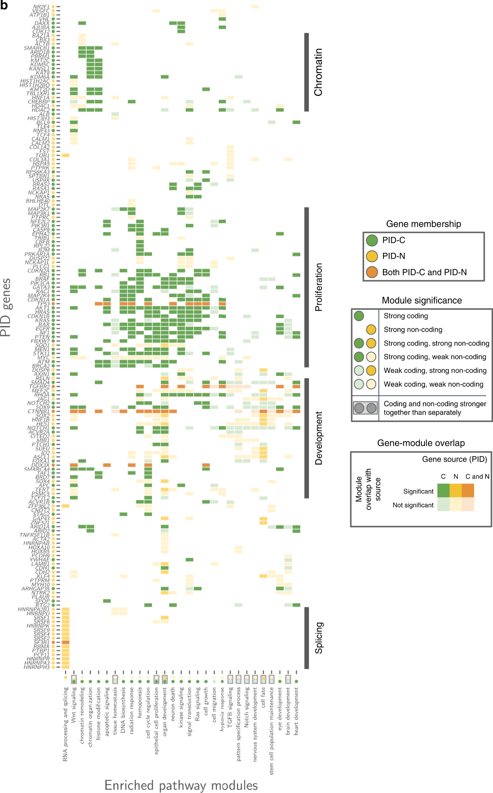
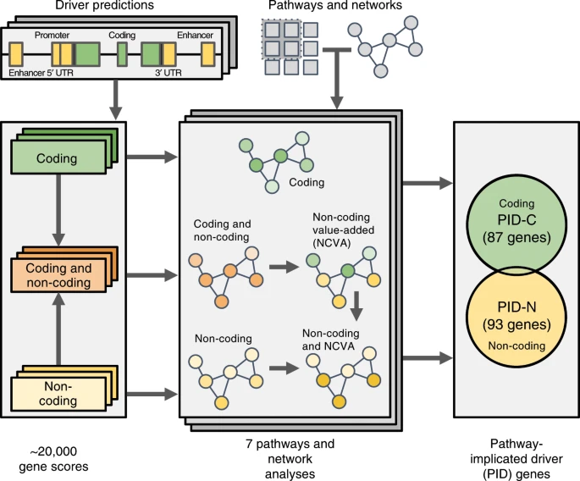
Pathway analysis
To identify pathways disrupted by somatic mutations
Potential therapeutic treatments targeting the pathways could be developed
Pathway and network analysis of more than 2500 whole cancer genomes (Reyna et al. 2020, Nature Comm)
Coding: chromatin remodelling and proliferation
Non-coding: RNA splicing
Coding and non-coding: Developmental pathways (Notch and Wnt signalling)
Notes:
The purpose of pathway analysis is to identify biological pathways altered/disrupted by somatic mutations. From there, we could understand more about the underlying mechanisms driving tumor development as well as potentially developing therapeutic treatments targeting the disrupted pathways. In the example here from the analysis of Pancancer analysis for whole genome (PCAWG), combined gene scores for coding and non-coding somatic mutations were used as input for multiple pathway and network analysis algorithms, which utilize multiple pathway/gene-set databases. As a result, they observed enrichment of different pathways altered by coding and non-coding genes.

Slide 48
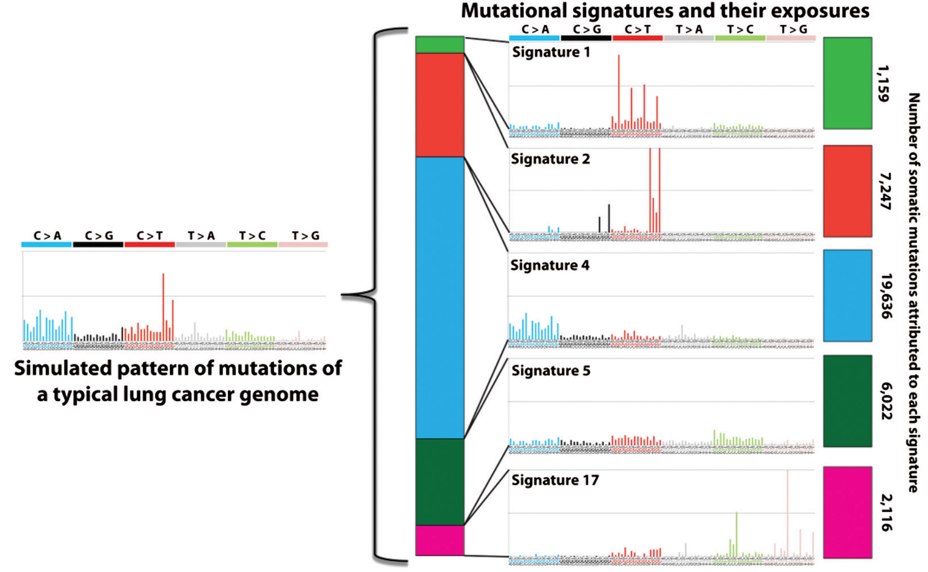
Mutational signatures
Different mutational processes generate unique combinations of mutation types, termed “Mutational Signatures”
Currently, four different variant classes are considered: SBS (Single Base Substitution), DBS (Double Base Substitution), ID (Small Insertion and Deletion), and CN (Copy Number Variation) Signatures
COSMIC signatures: https://cancer.sanger.ac .uk/signatures/
For additional databases for mutational signatures (see session 2) and details for mutational signature analyses (see session 5, January 18, 2023)
Figure from Petljak and Alexandrov, Carcinogenesis, 2016
Notes:
It has become increasingly popular to perform mutational signatures analysis in somatic analysis. Basically, different endogenous and exogenous mutational processes generate unique combinations of mutation types or patterns and they are termed mutational signatures.

Slide 49
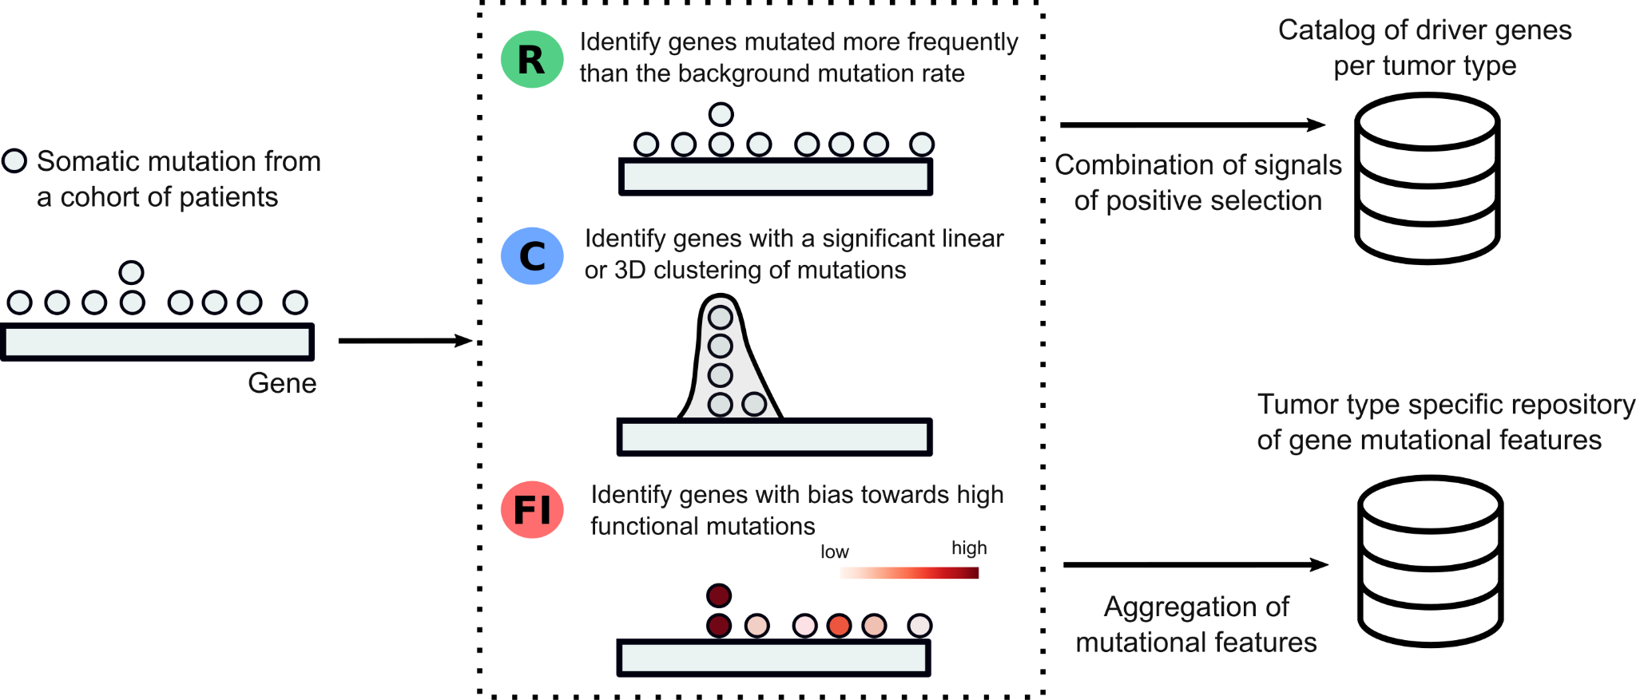
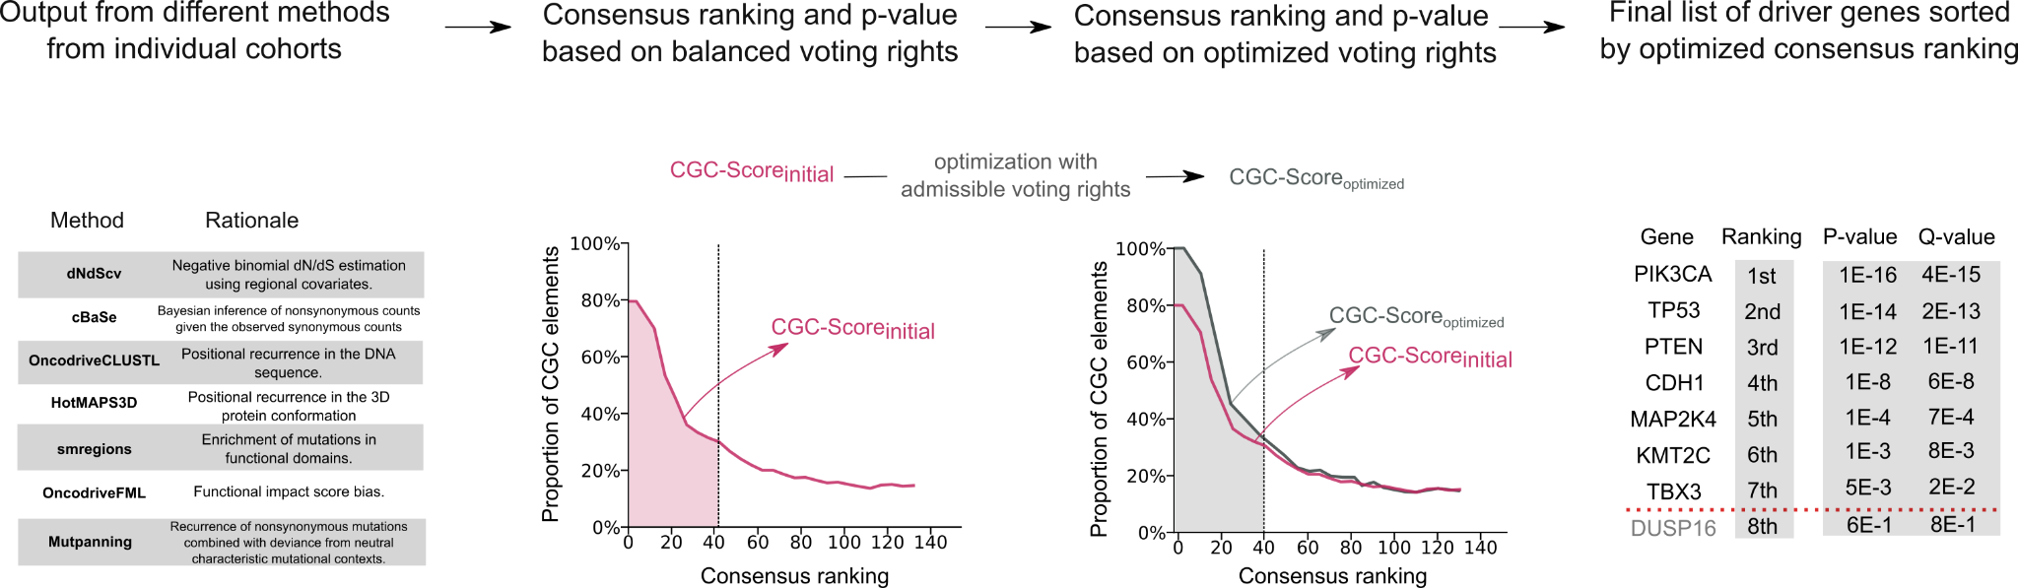
Cancer driver genes
IntOGen pipeline (Session 2) runs 7 different driver gene identification methods and combines their output.
More on this in session 8 (March 13, 2023)
Notes:
Cancer driver genes are those whose mutations confer selective advantage to cancer cells for proliferation and survival. Therefore, it is important to identify them. There are multiple software developed to help identify cancer driver genes from NGS data, and among them, Intogen pipeline runs 7 different driver gene identification methods and combines their output together. Intogen was introduced in session 2, and we will discuss more about this in great details in session 8.

Slide 50
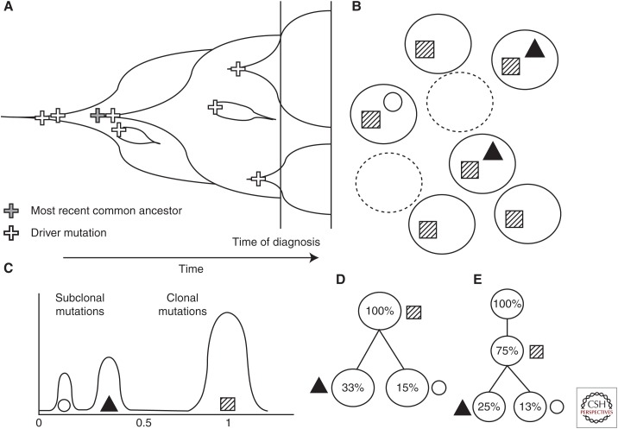
Mutational clonality analysis
Over time, clonal expansions can occur, resulting in the increase of subpopulations of cells harboring distinct sets of mutations.
Using allele frequencies of mutations from sequencing data, accounting for copy number aberrations and tumor purity, an estimate of cancer cell fraction (CCF) for each mutation can be obtained.
Clustering algorithms can be applied to mutations CCF to estimate number and CCF of each subclone.
Relationship of each subclone can be then reconstructed and visualized.
More information in session 9 (March 20, 2023)
CCF
Normal cells
Tumor cells
Dendro et al. 2017
Notes:
E.g. subpopulations of cells contain square and circle mutations, and others contain square and triangle mutations.

Slide 51
Thank you for your attention!
Questions?
Next: Practical Session 4 (10:45am)

